Slide 1
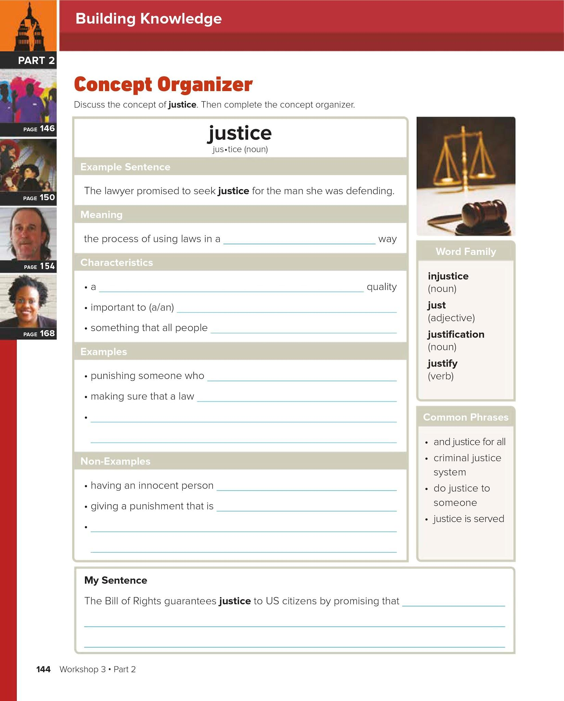
fair
positive
judge
deserve
Broke the law
Affects everyone in the same way
A fair trial
Go to prison
Too harsh
Denying people their rights
Everyone will be treated equally

Slide 2
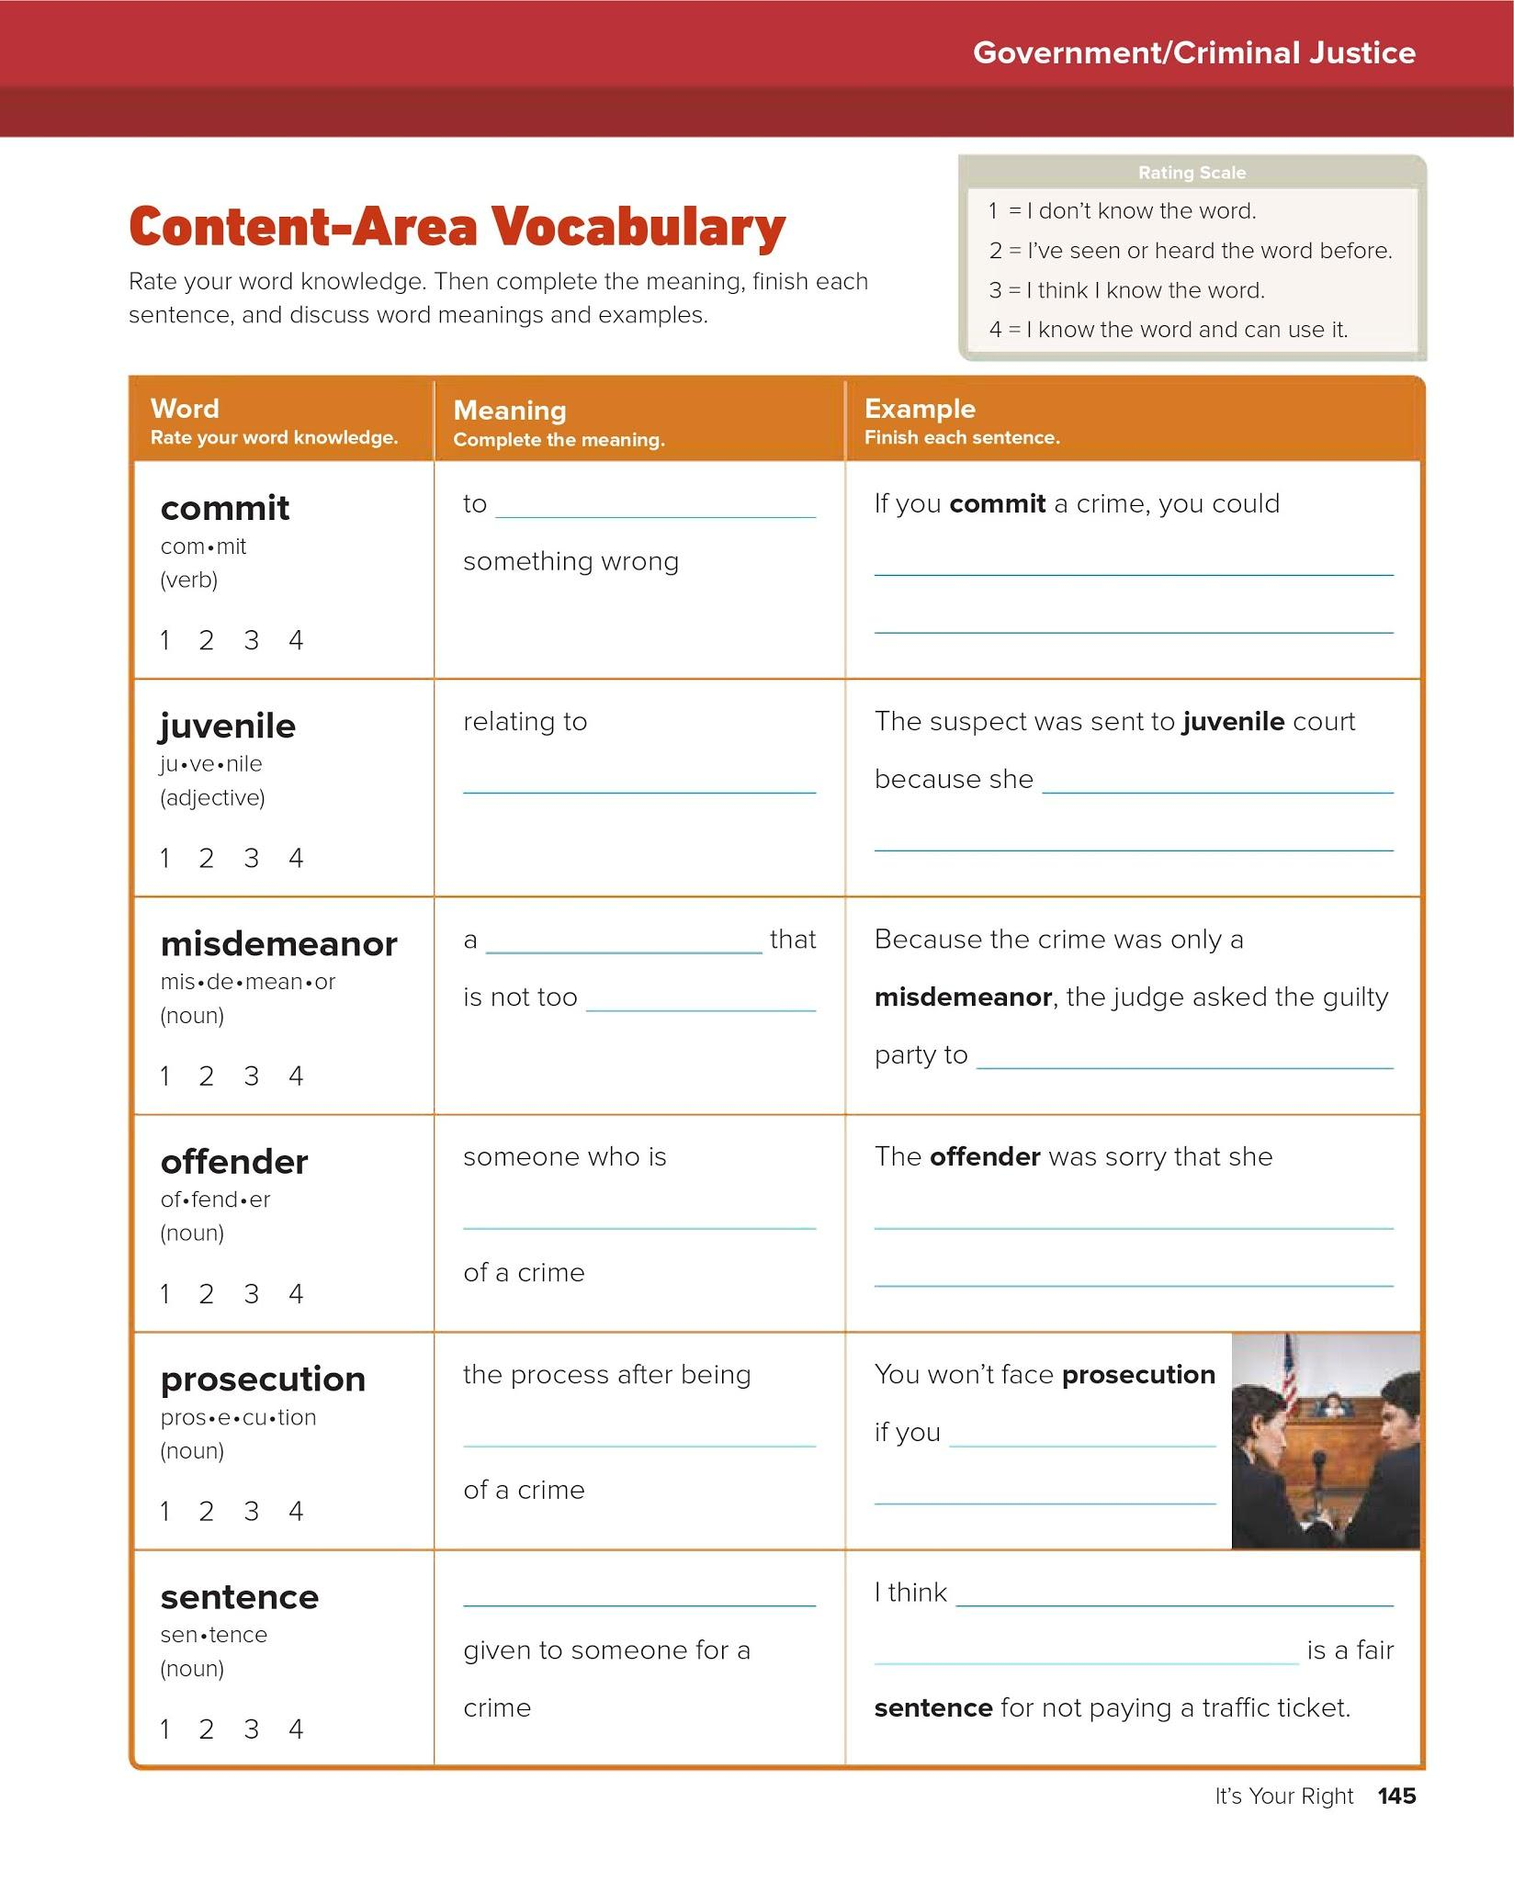
do
Go to jail
youth
Was 16 years old.
crime
Serious
Pay to fine
Guilty
Stole something
Accused
Don’t commit a crime
Punishment
Losing your license

Slide 3
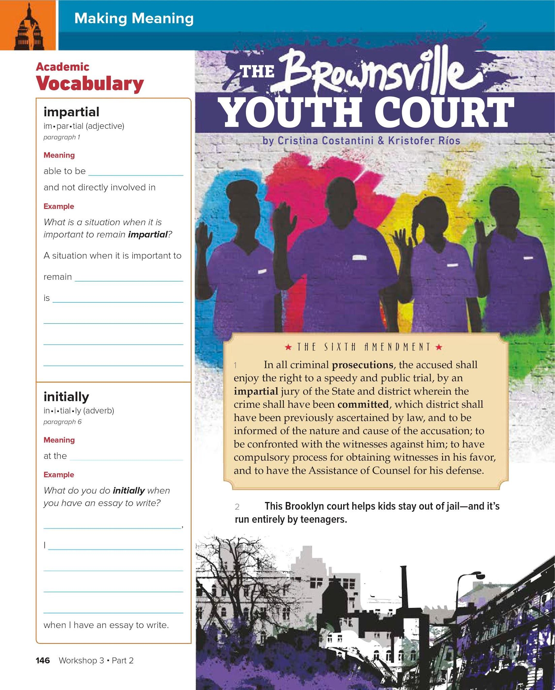
Fair
Impartial
Judging a contest
beginning
Initially
brainstorm ideas

Slide 4
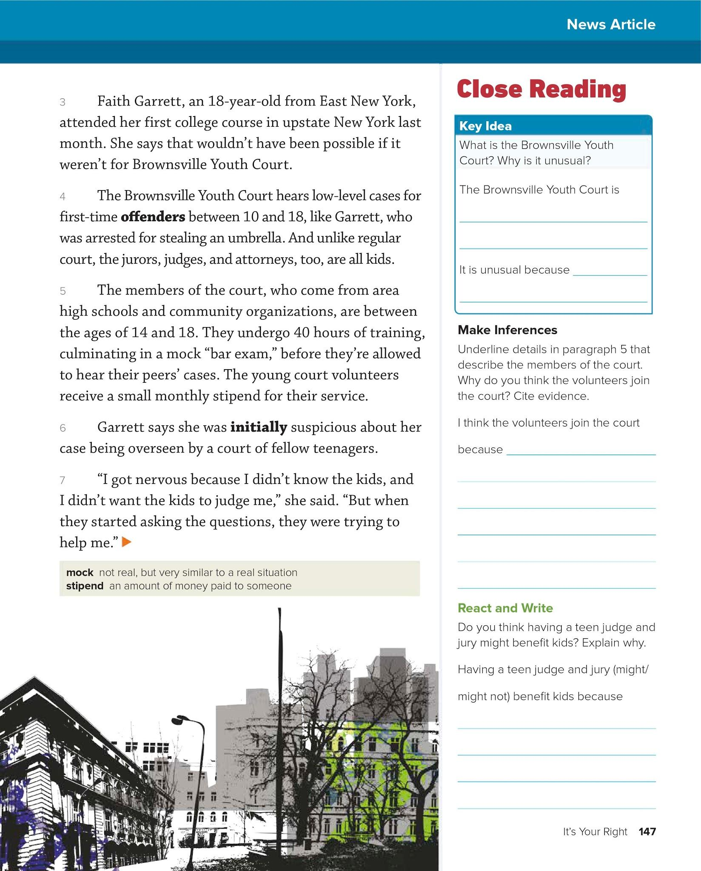
a court for teenagers
Teens run the court
they can relate to the teens.

Slide 5
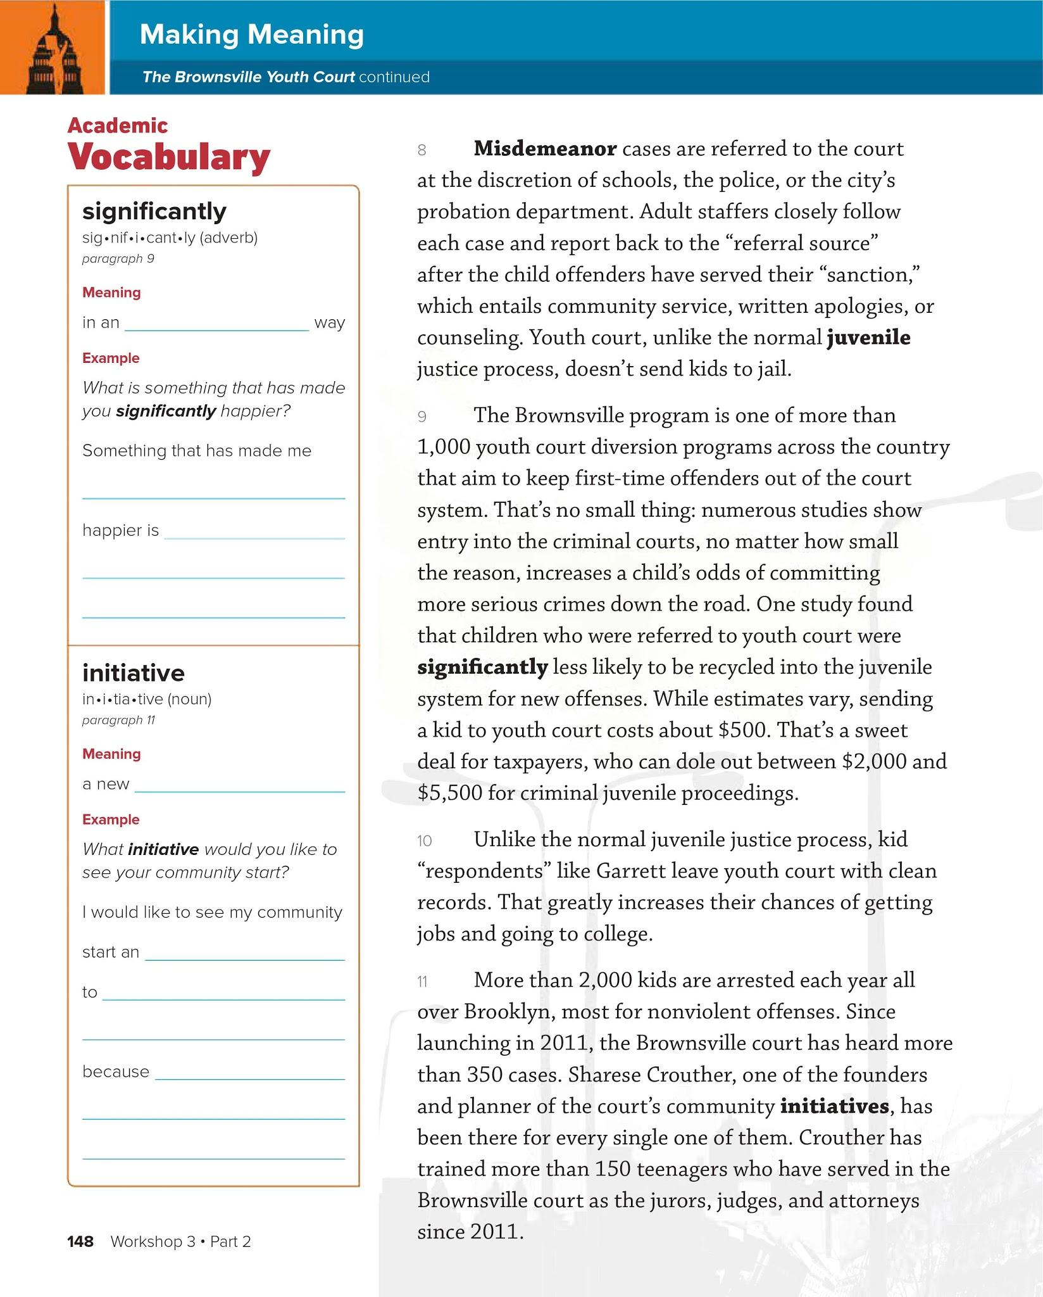
important
significantly
When I passed my math class
plan
Initiative
Open up the swimming pool
people want to use it.

Slide 6
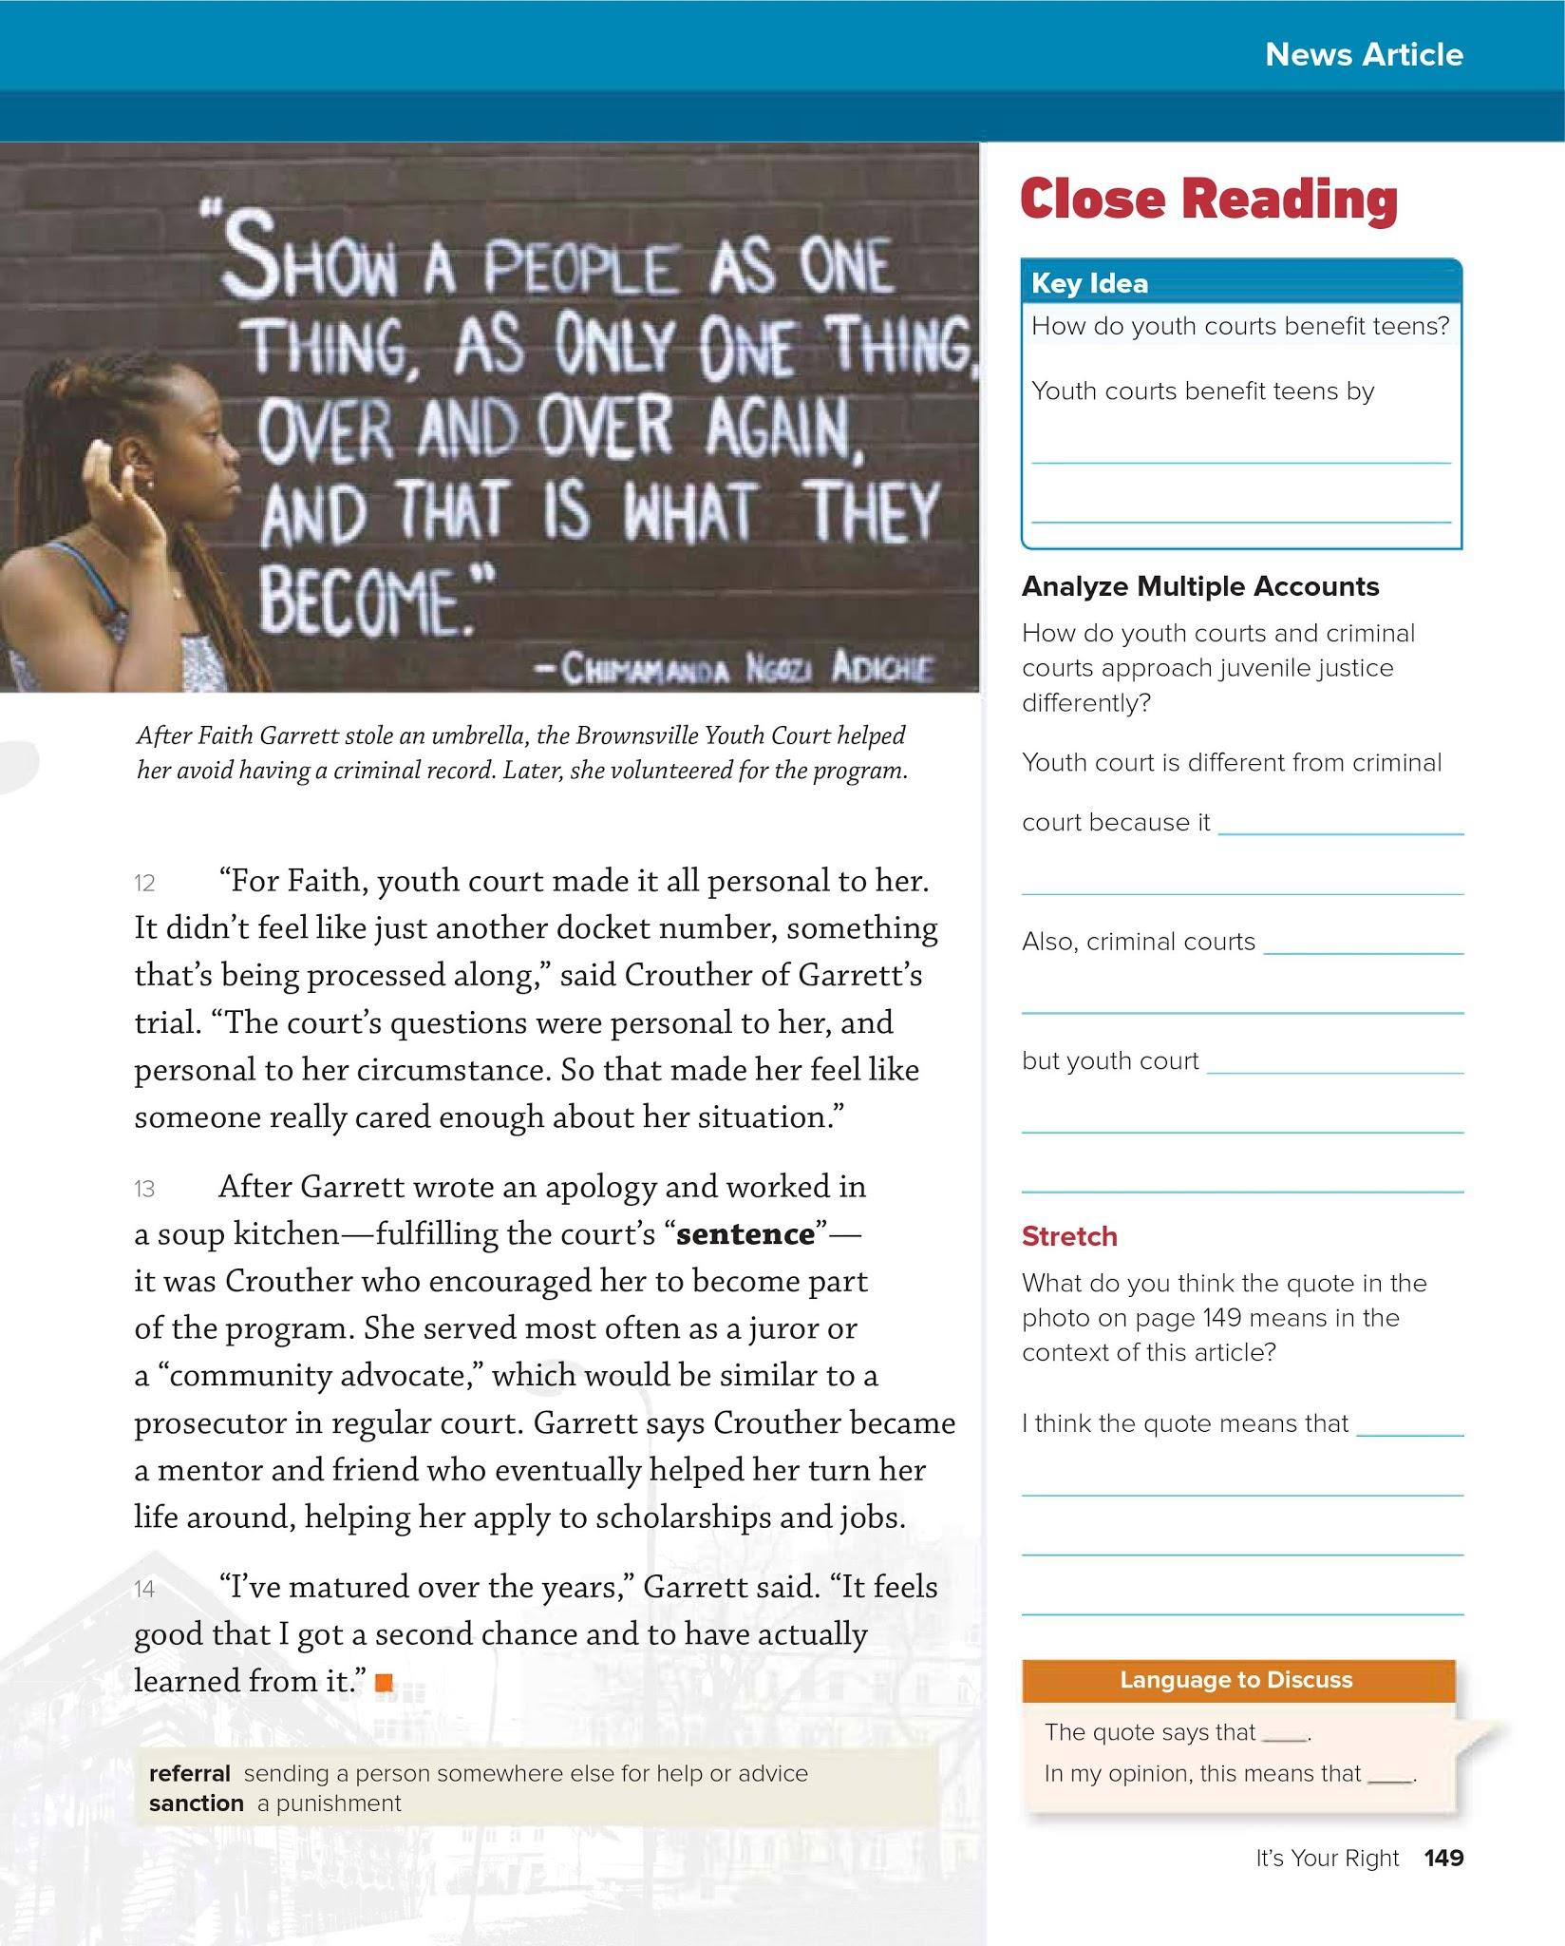
Don’t send them to jail.
doesn’t give you a record.
Cost up to $5,500
Costs $500
If you treat someone like a criminal they become one.

