Slide 1
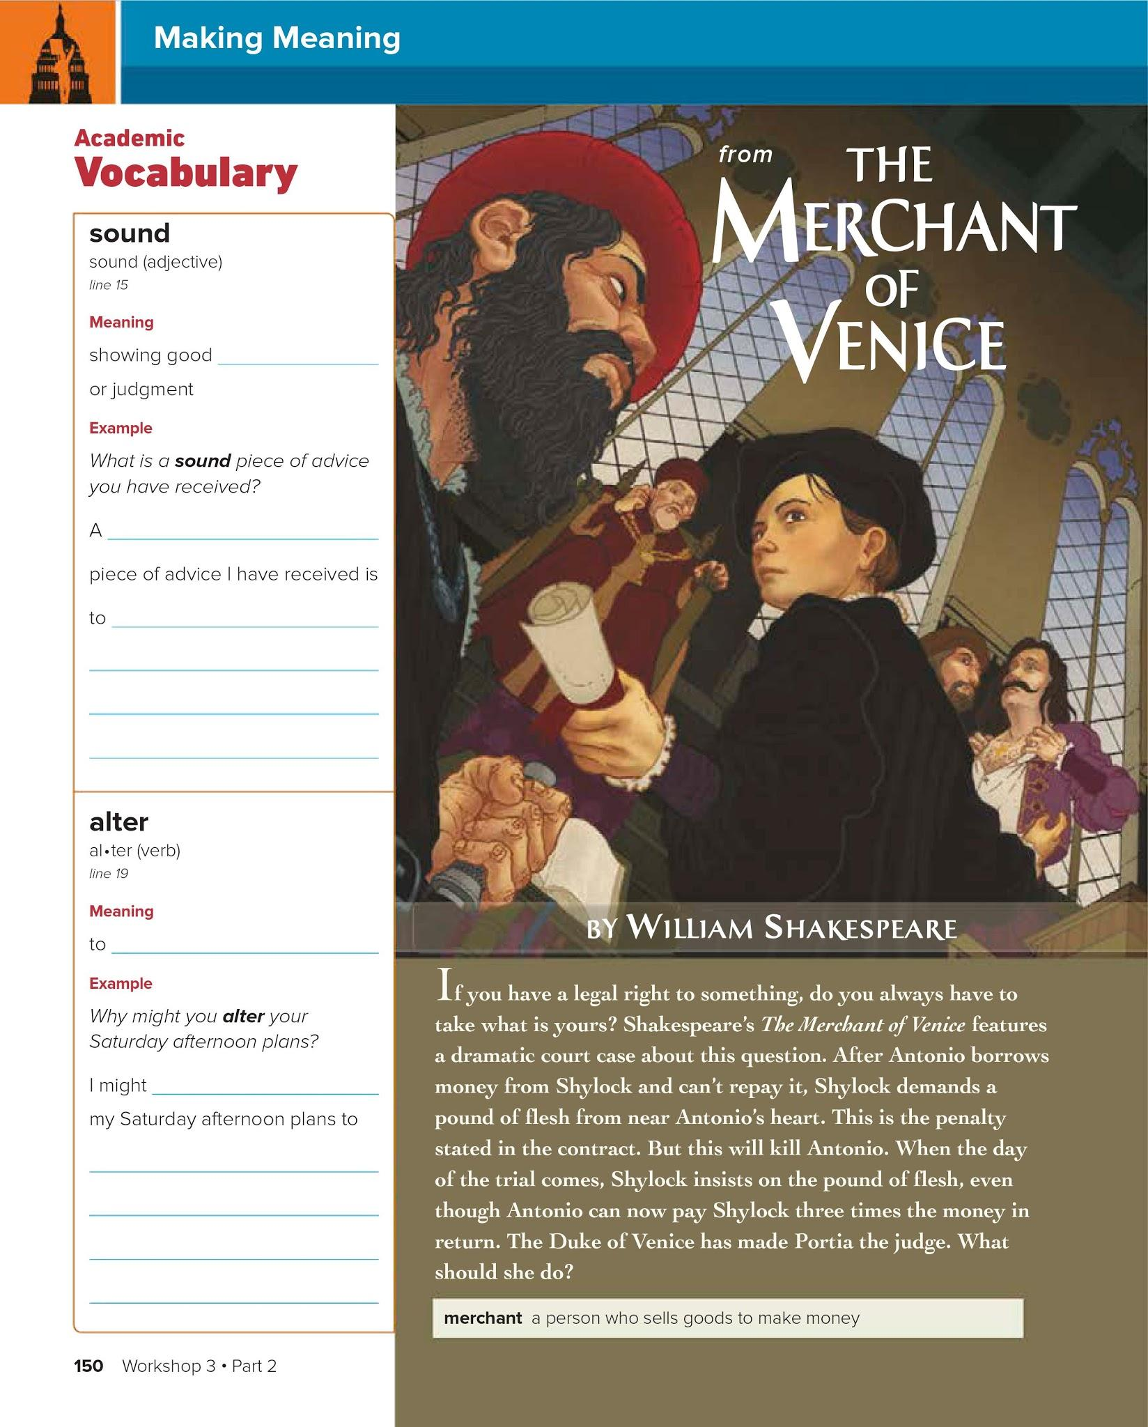
sense
sound
Pass all your classes
change
alter
Babysit my sister

Slide 2
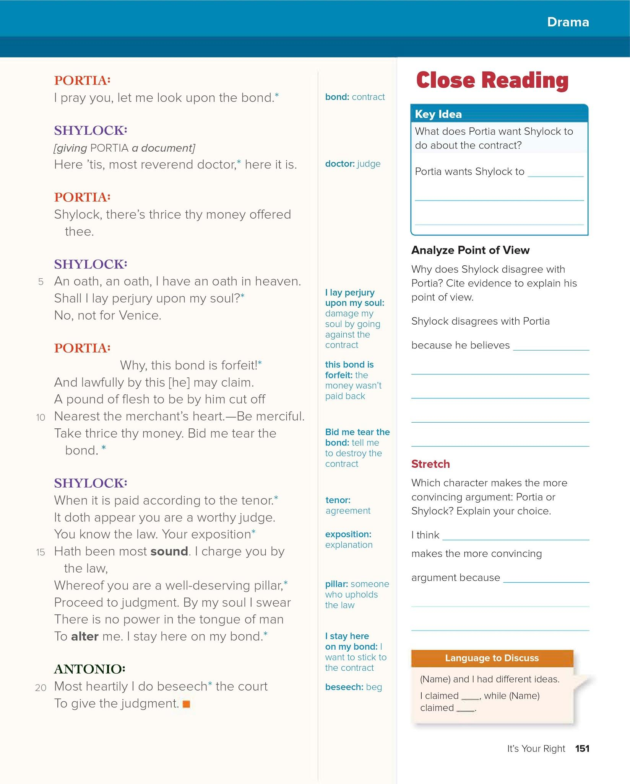
Destroy the contract
It will damage his soul
Portia/Shylock

Slide 3
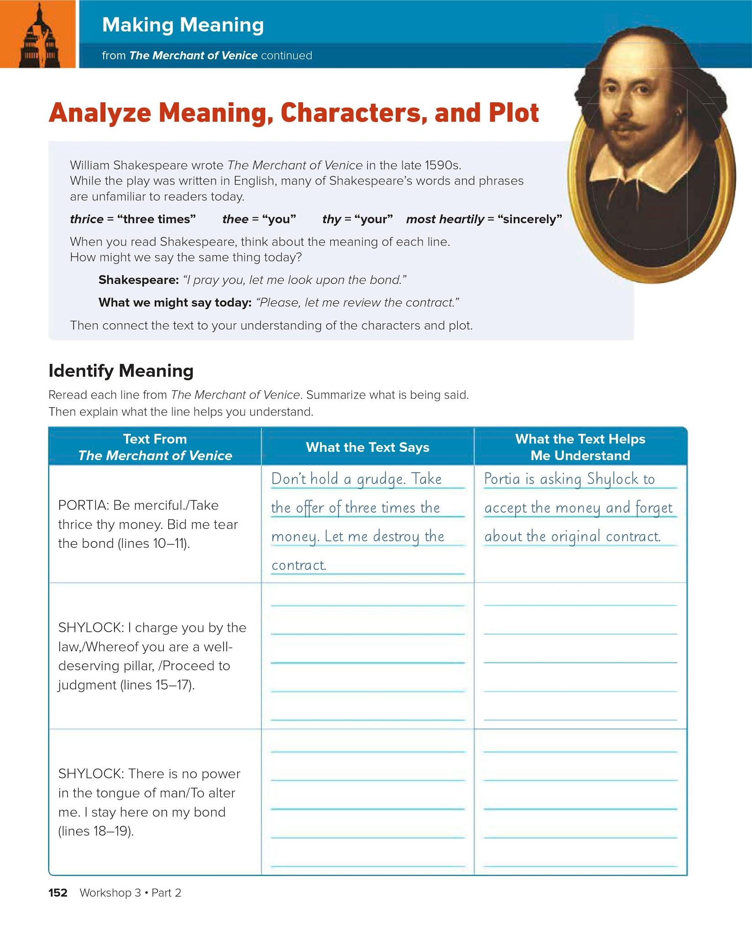

Slide 4
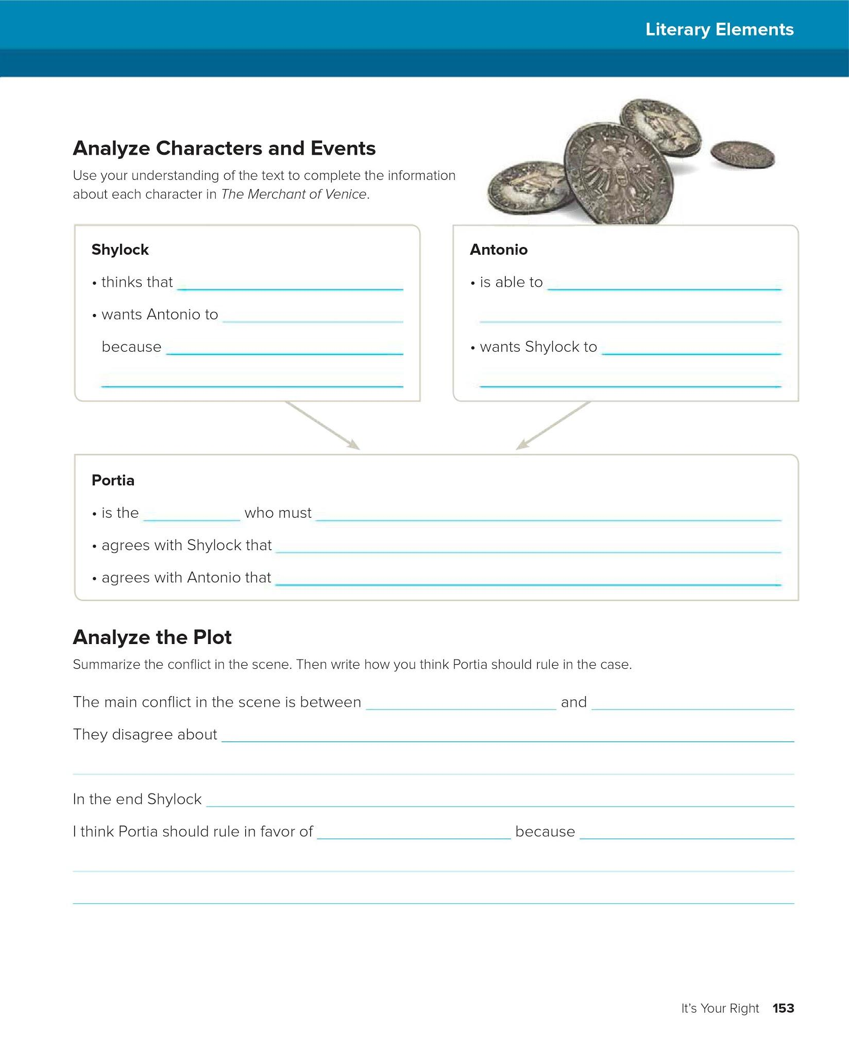
it’s important to follow the contract
Give him three times the money
Die
That is what the contract said
Take the money and not kill him
Judge
decide if Antonio dies.
The contract is valid
Shylock should take the money
Portia
Shylock
the contract.
Doesn’t change his mind
Antonio/Shylock

Slide 5
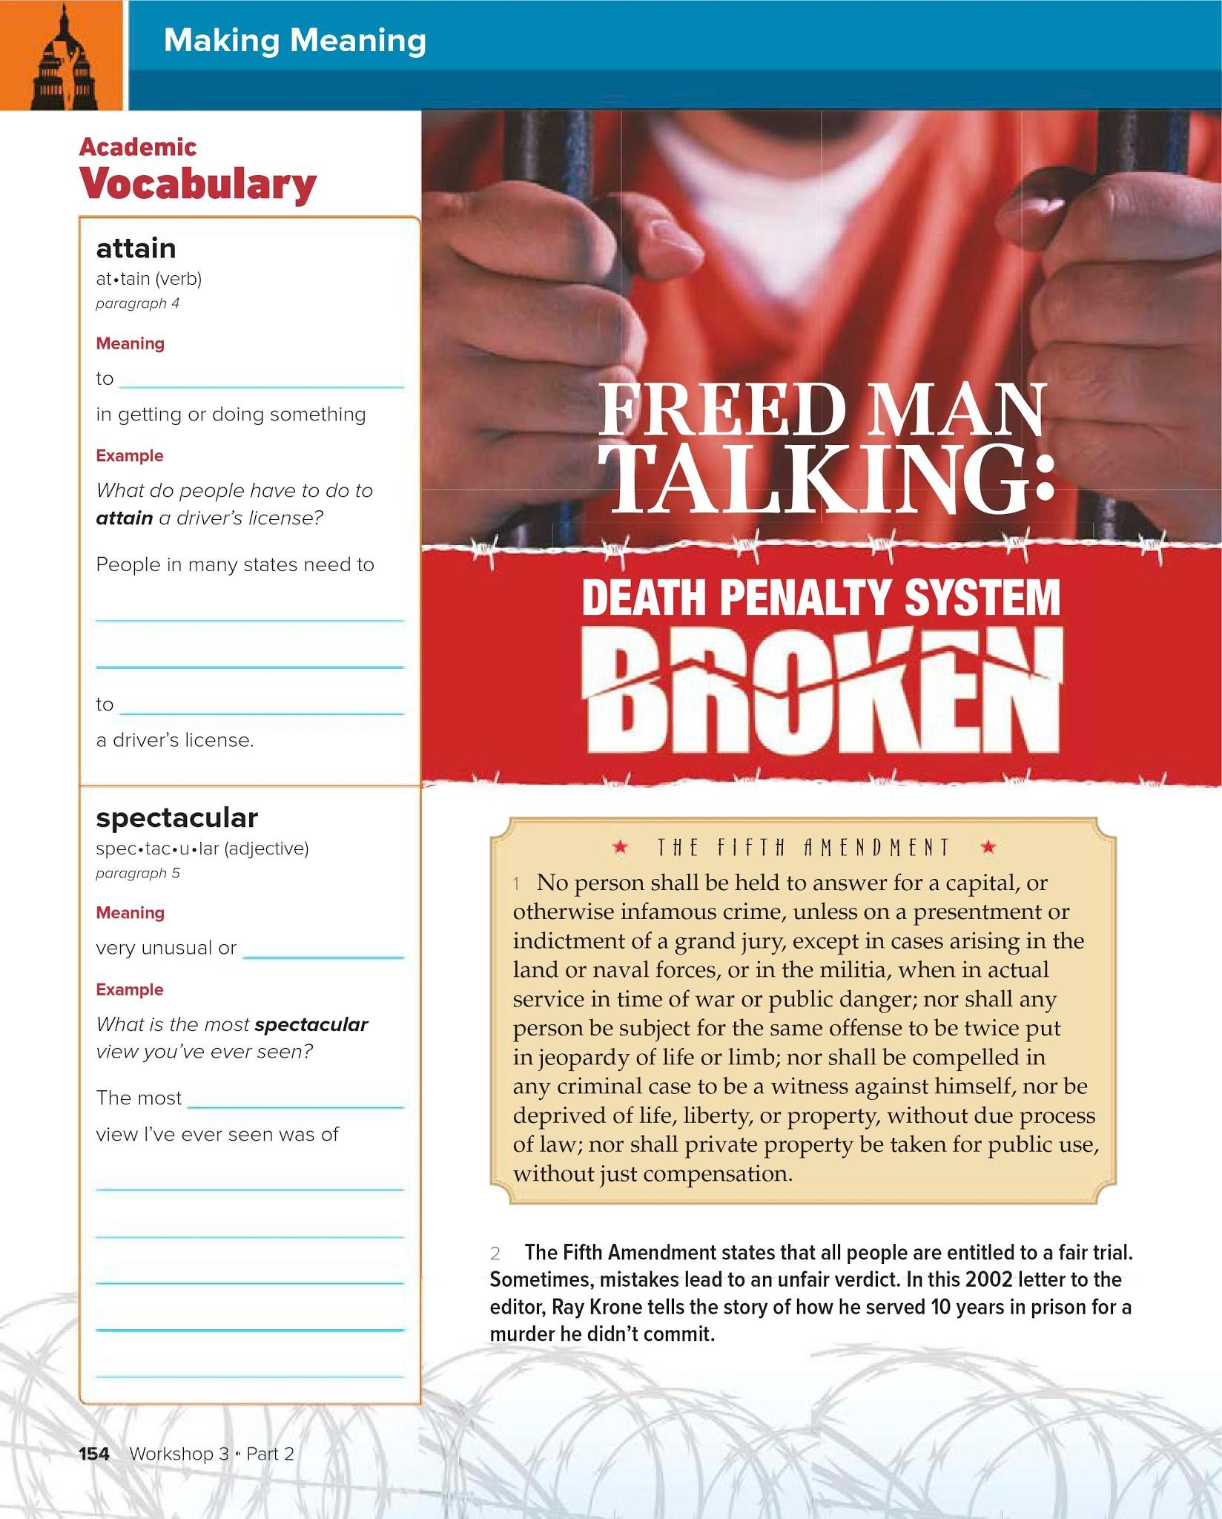
succeed
Take a test
attain
amazing
spectacular
The sunset over the mountains

Slide 6
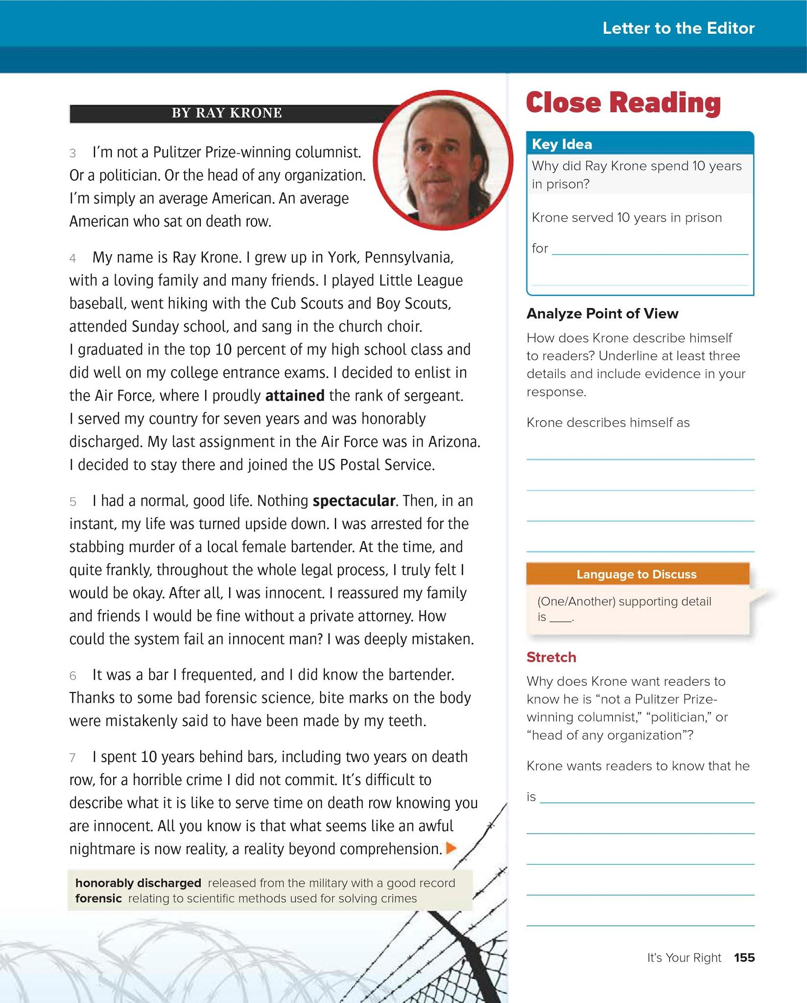
Murdering a woman
An average American
Just like us.

Slide 7
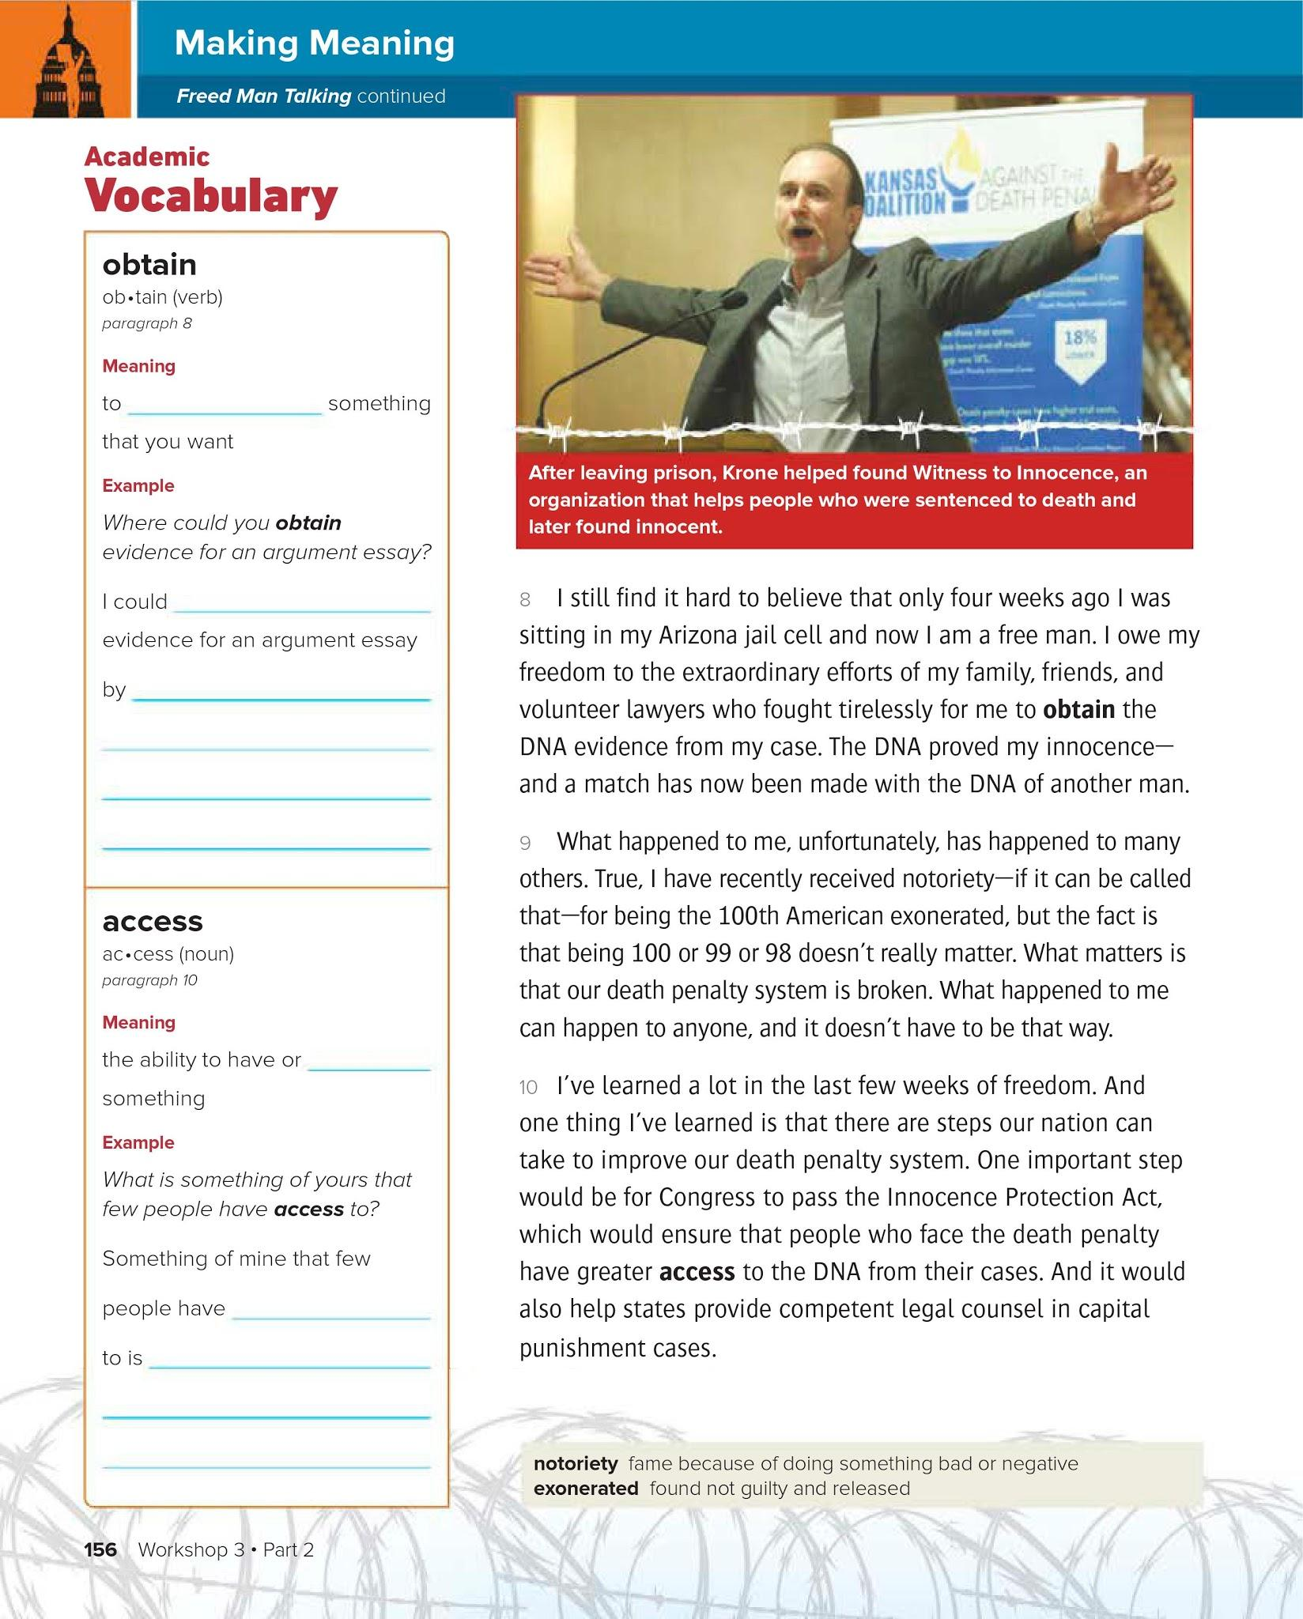
get
obtain
looking on the Internet
get
access
My social media accounts.

Slide 8
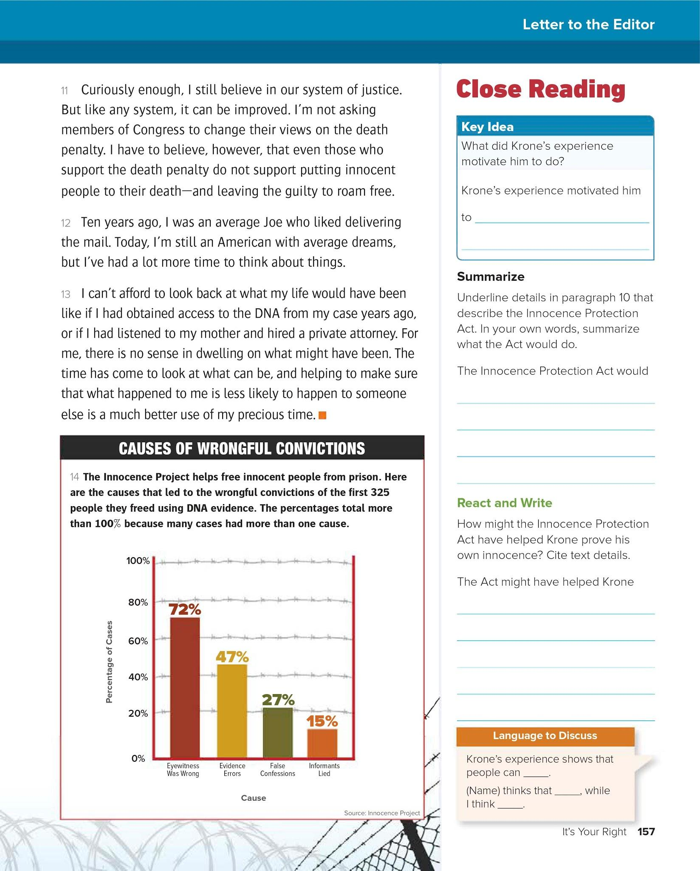
Improve the system so others don’t get treated this way.
Allow people on the death row to obtain DNA and a lawyer.
Get out of jail earlier

