Slide 1
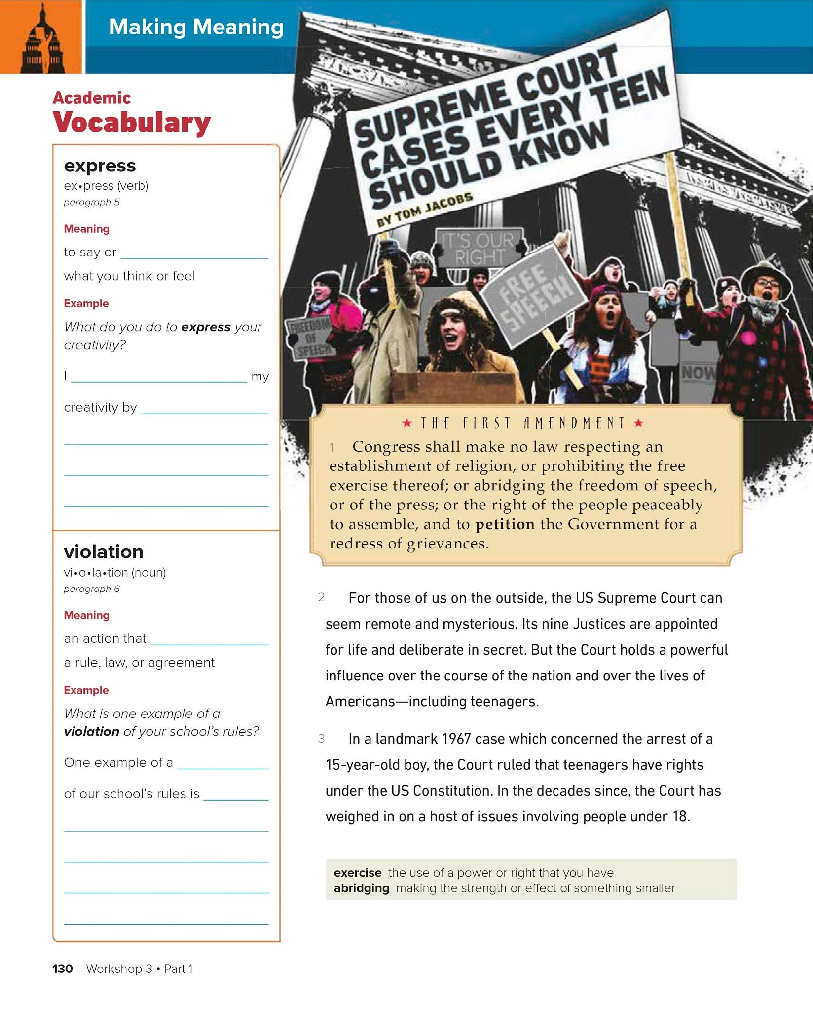
Triple click to type
Triple click to type
Triple click to type
Triple click to type
Triple click
Triple click to type

Slide 2
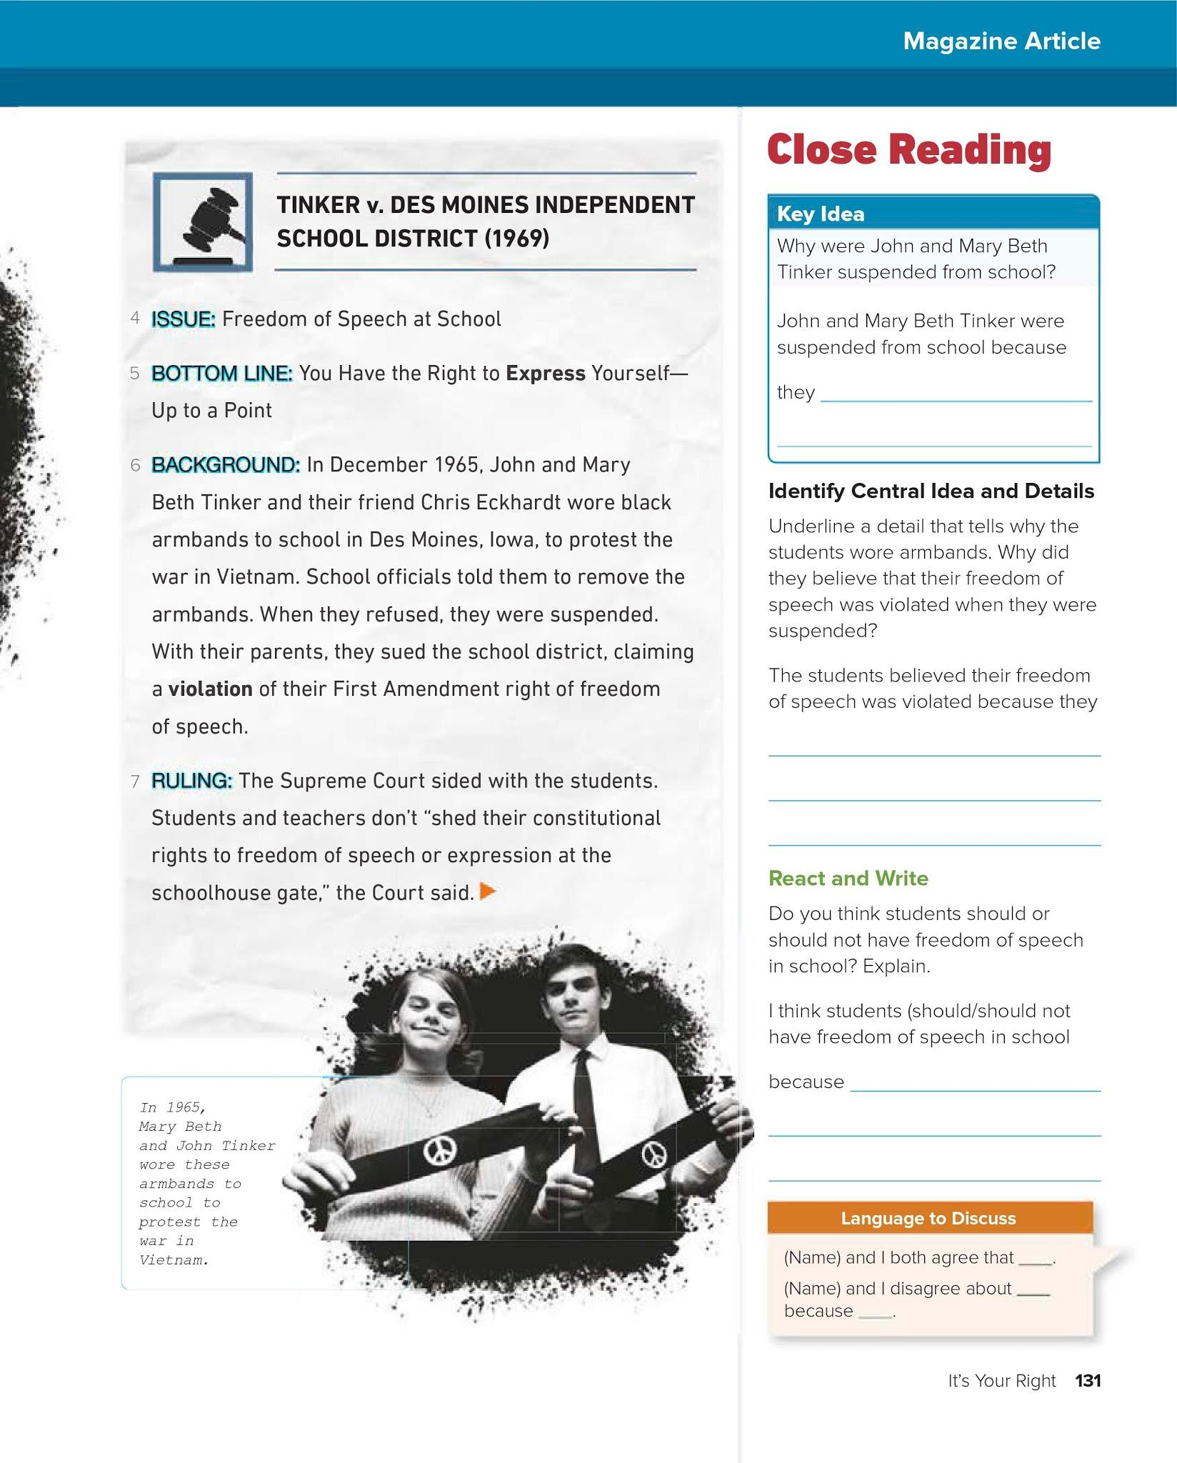
Triple click to type
Triple click to type
Triple click to type

Slide 3
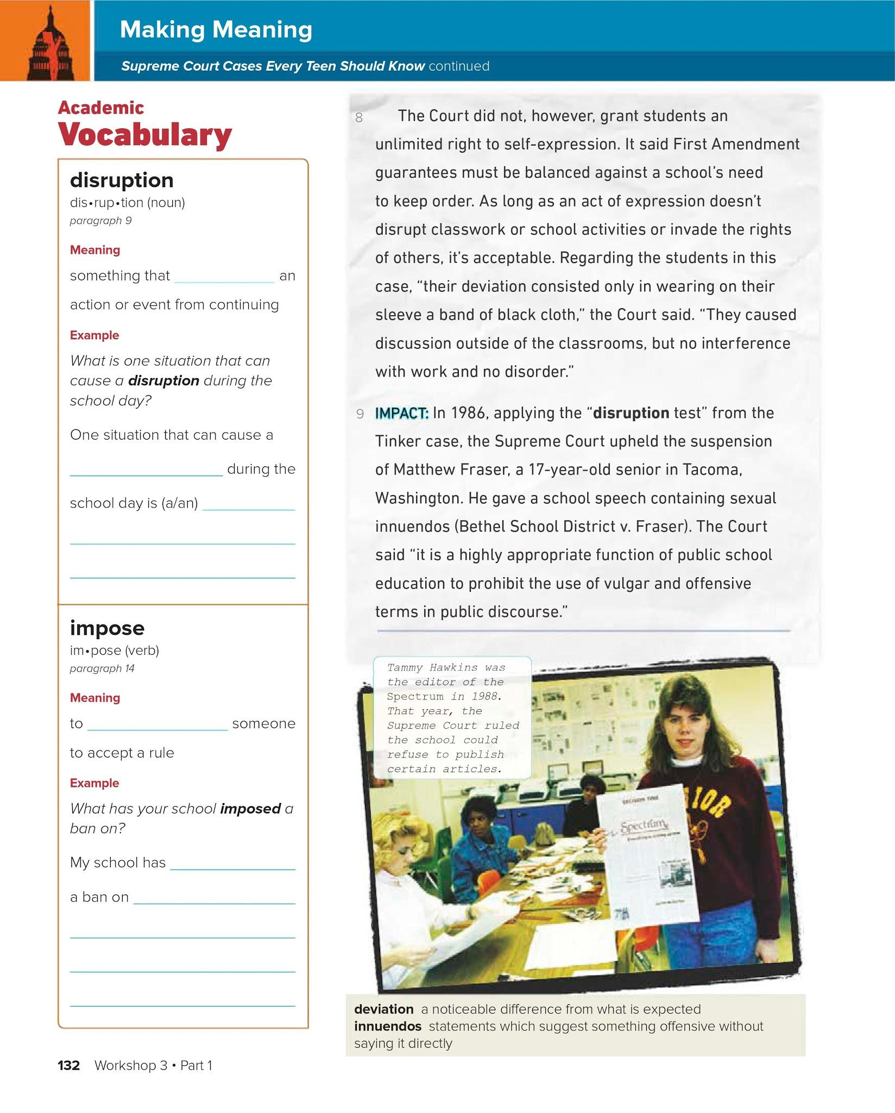
Triple click
Triple click to type
Triple click to type
Triple click to type
Triple click
Triple click to type

Slide 4
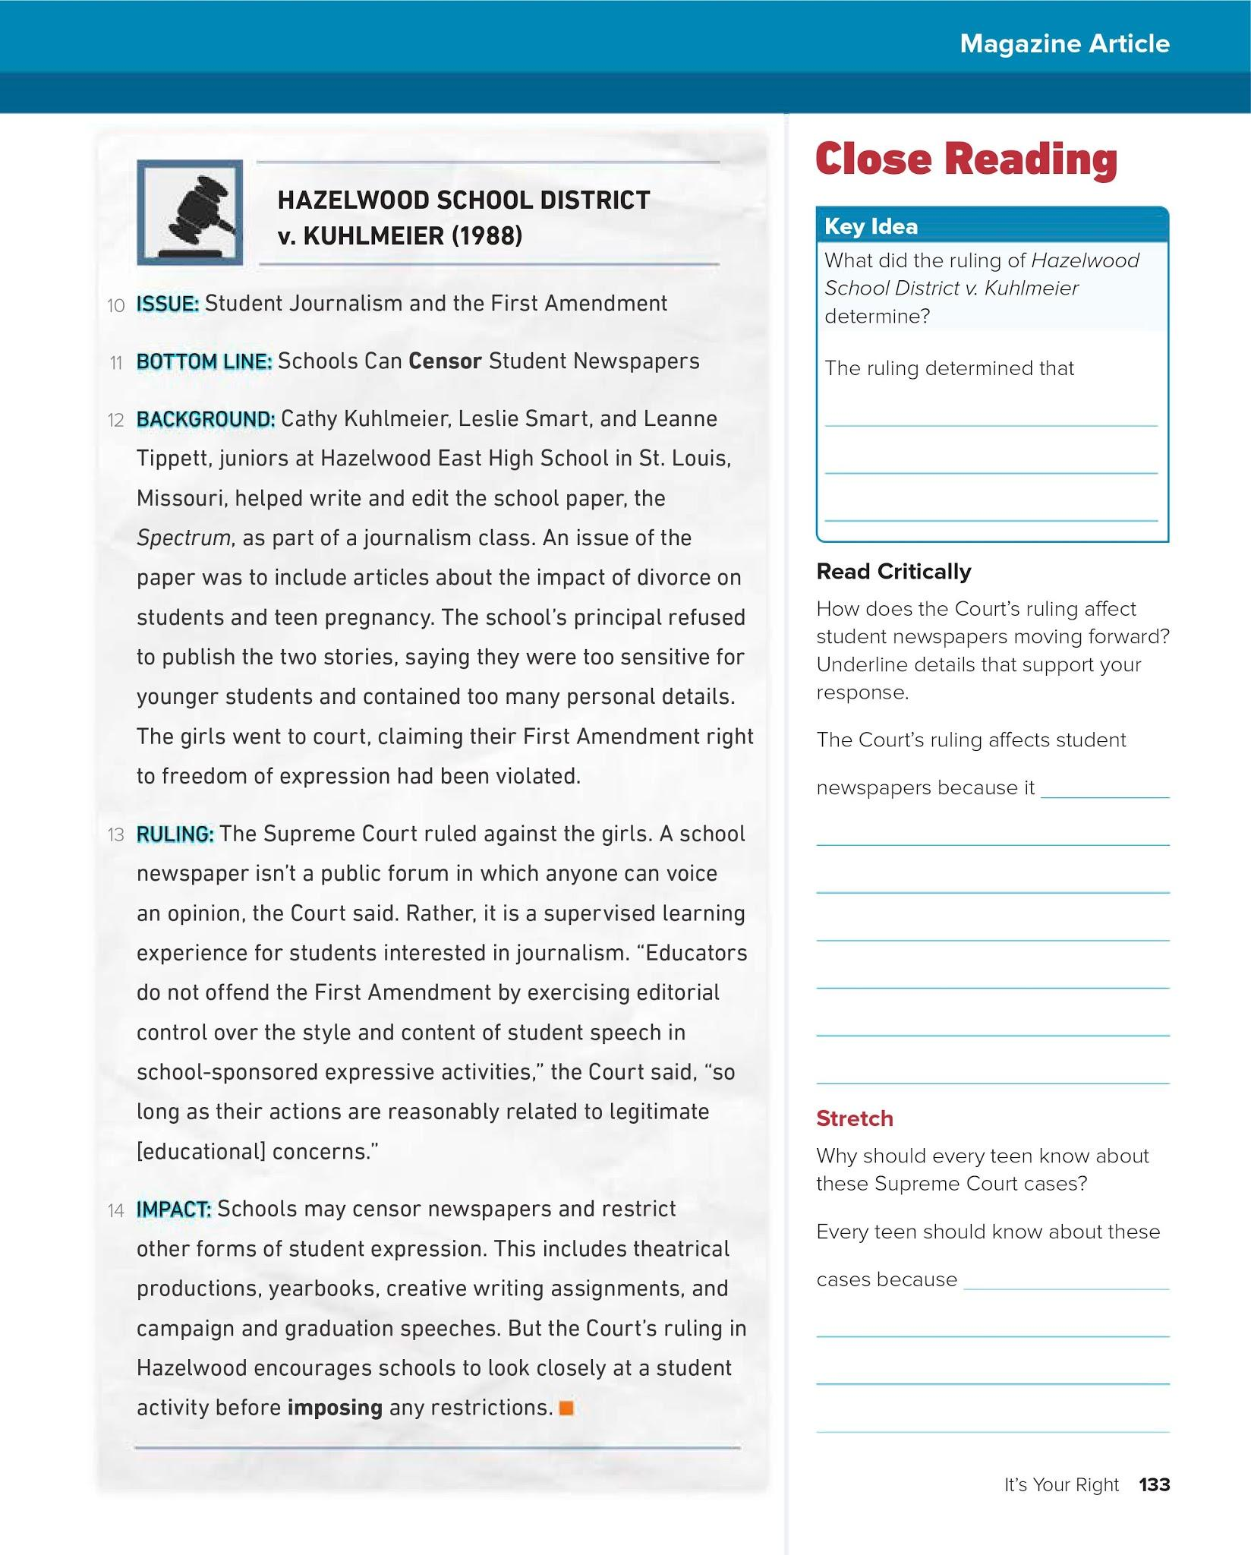
Triple click to type
Triple click to type
Triple click to type

Slide 5
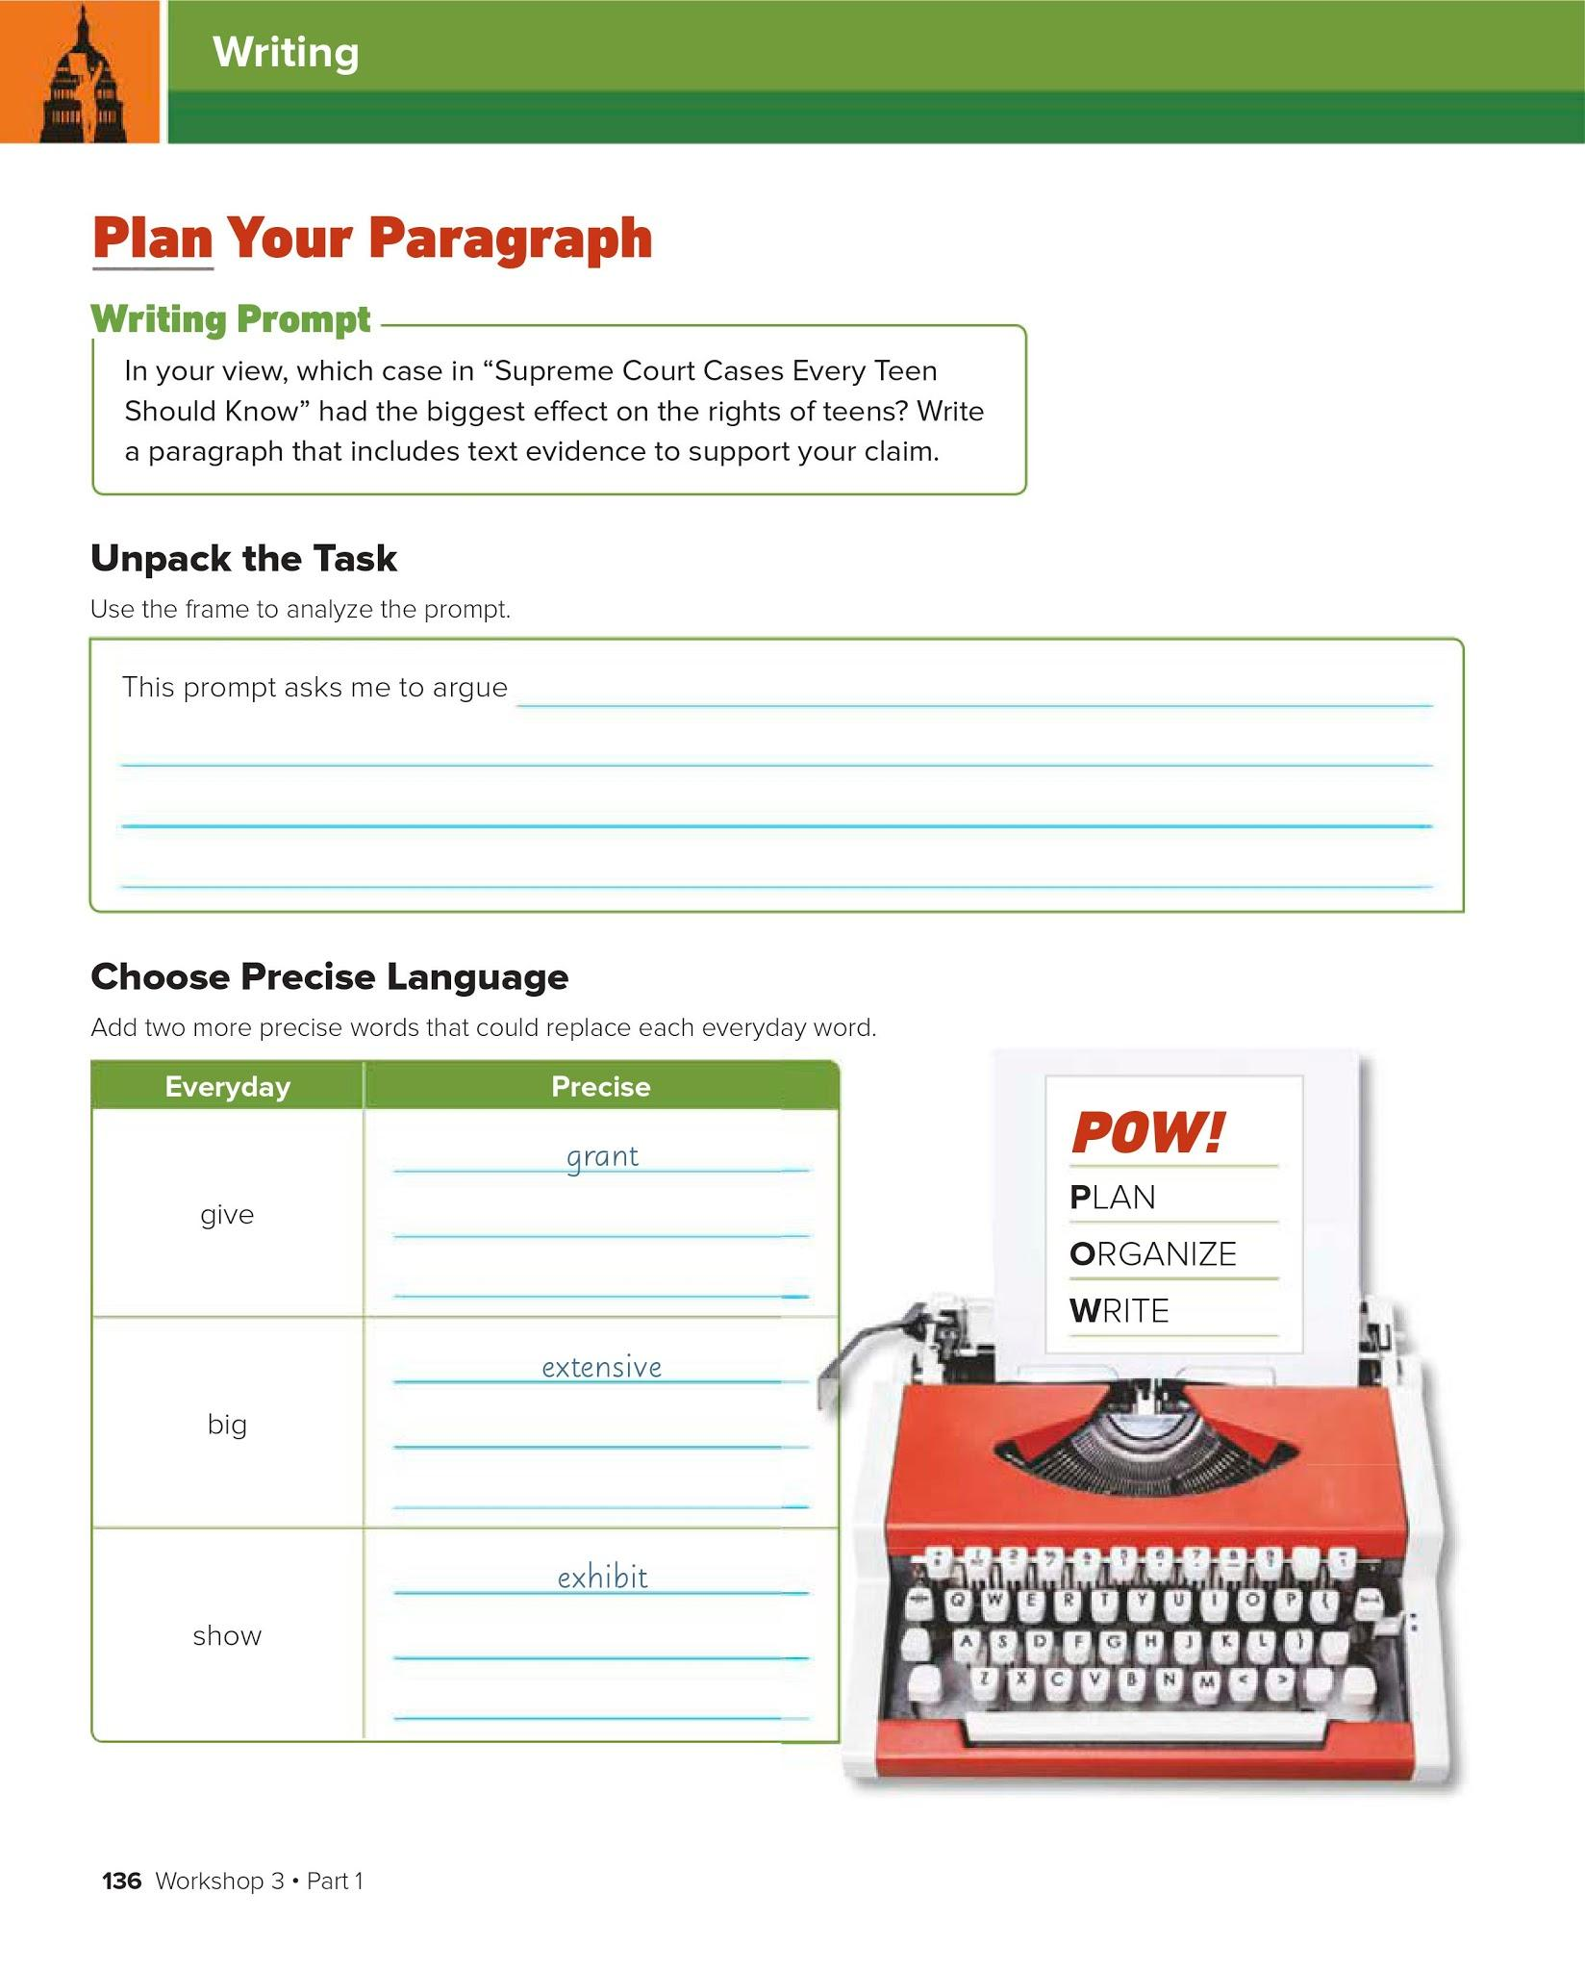
Triple click to type
Hint: Go to thesaurus.com to get ideas for these words!
Triple click to type
Triple click to type
Triple click to type
Triple click to type
Triple click to type
Triple click to type

Slide 6
