Slide 1


Slide 2


Slide 3


Slide 4
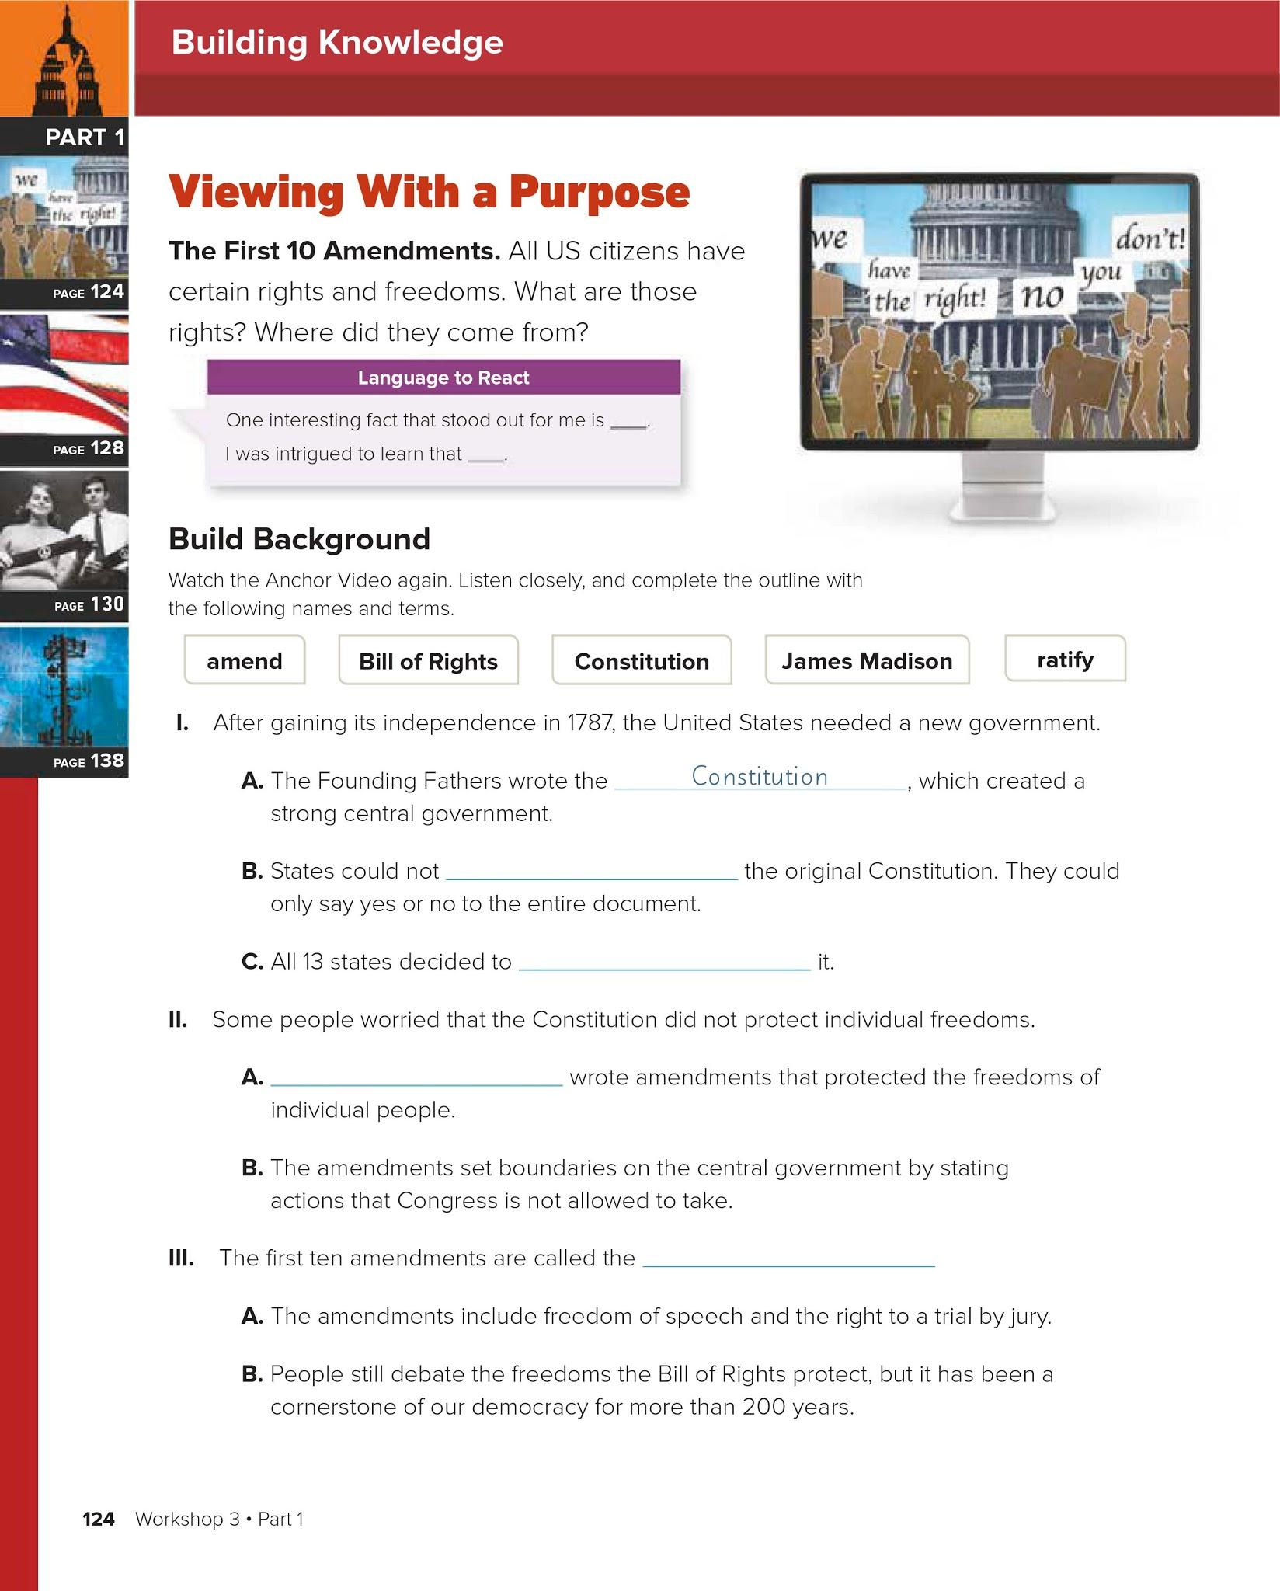
Triple click to type here
Triple click to type here
Triple click to type here
Triple click to type here

Slide 5
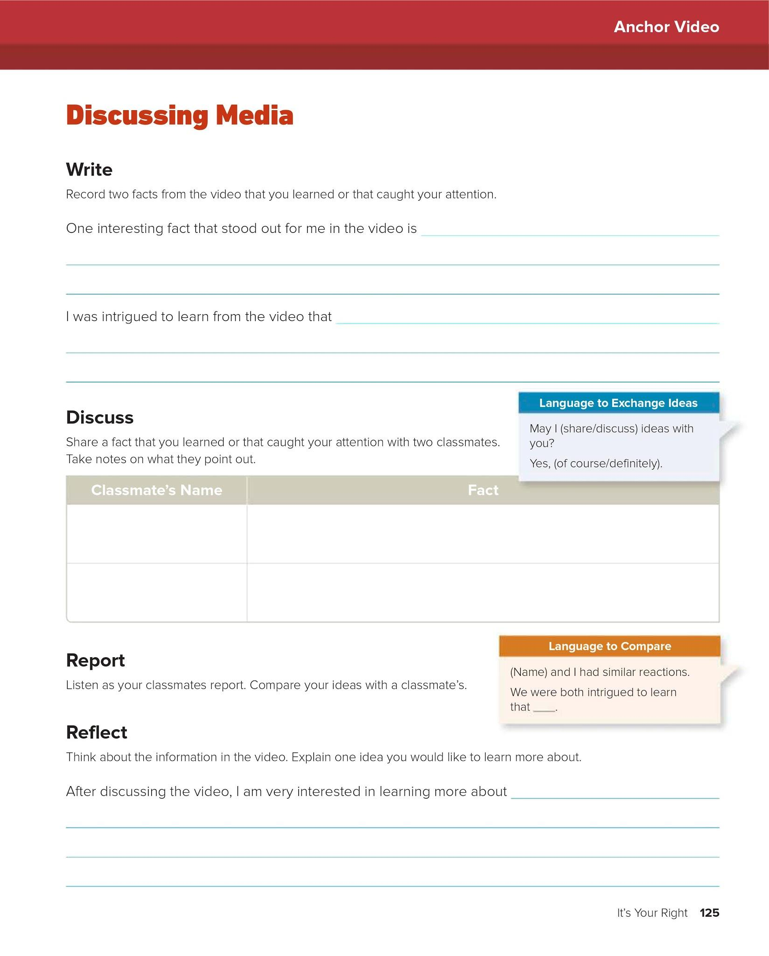
Triple click to type here
Triple click to type here
If you are working independently/remotely, you do not need to complete this part.
If you are working independently/remotely, you do not need to complete this part.

Slide 6
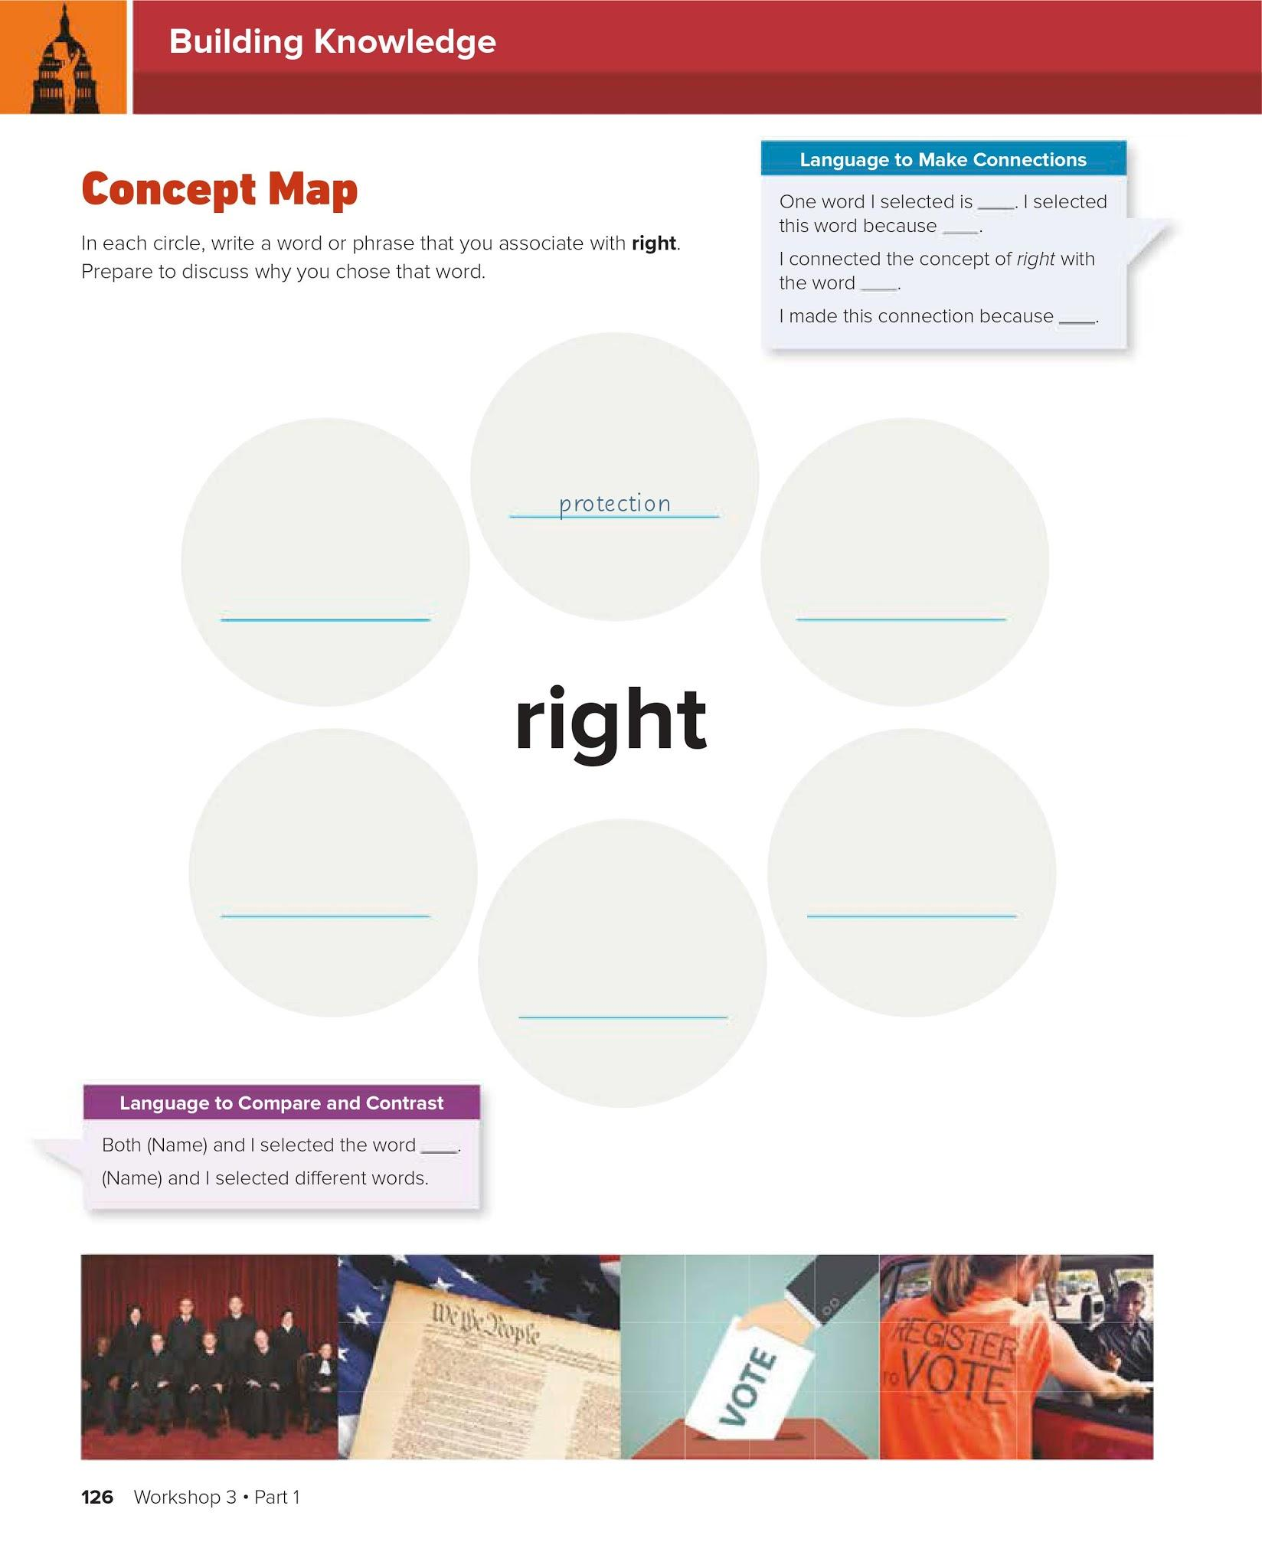
Triple click to type here. Use one of the sentence frames from the “Language to Make Connections box above.
Triple click to type here
Triple click to type here
Triple click to type here
Triple click to type here
Triple click to type here

Slide 7
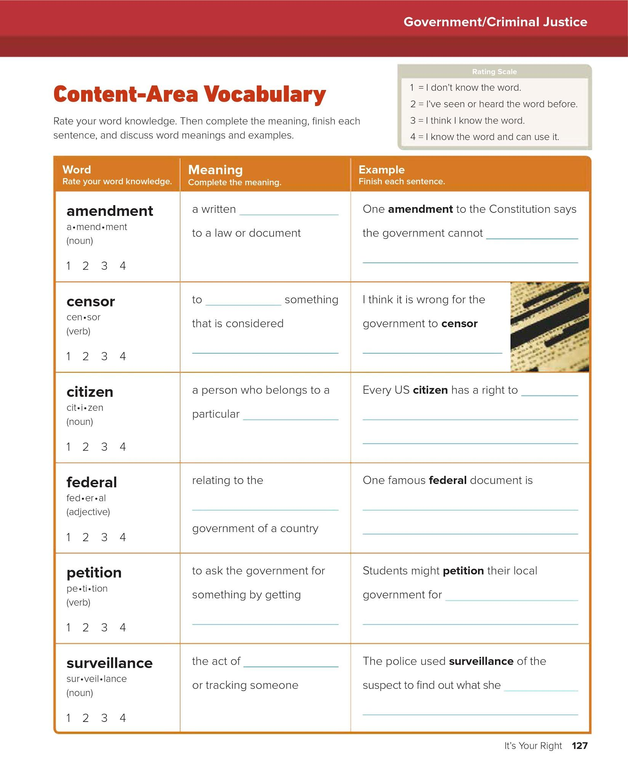
Move the red circles below to rate your knowledge of the word according to this scale.
Triple click to type here
Triple click to type here
Triple click to type here
Triple click to type here
Triple click to type here
Triple click to type here
Triple click to type here
Triple click to type here
Triple click to type here
Triple click to type here
Triple click to type here
Triple click to type here
Triple click to type here

Slide 8
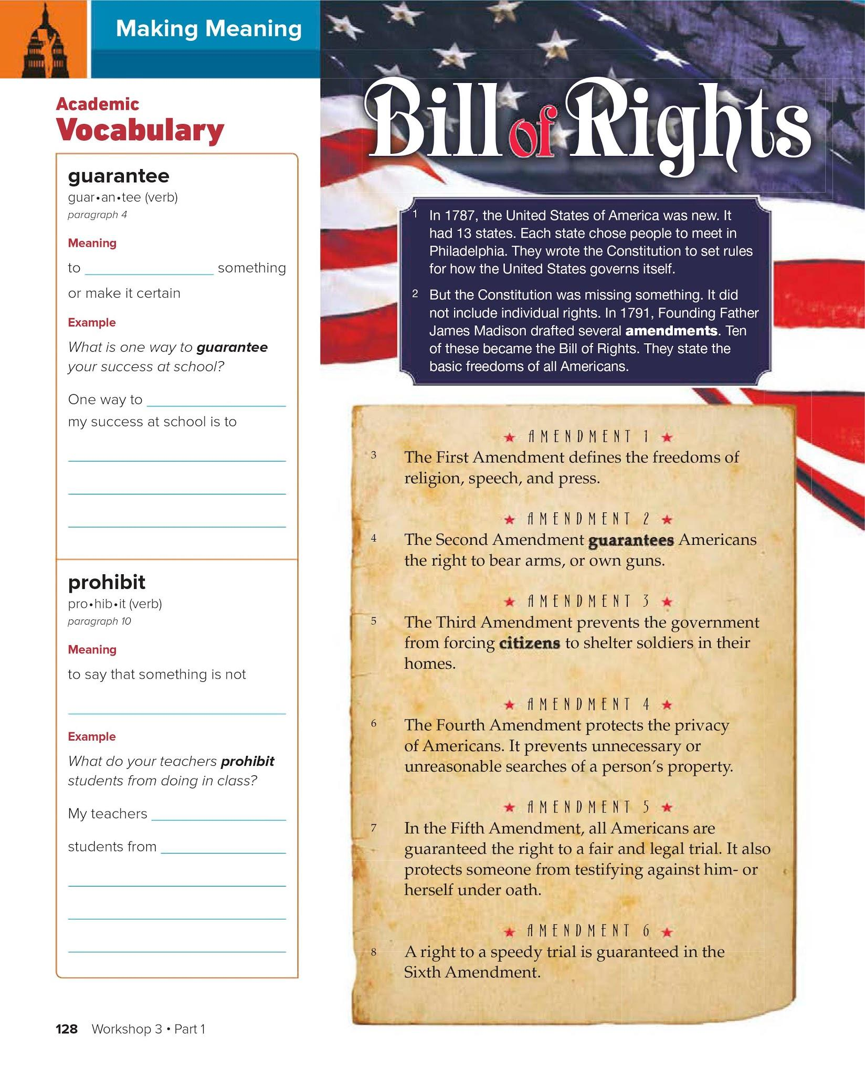
Triple click to type
Triple click to type
Triple click to type
Triple click to type
Triple click to type
Triple click to type

Slide 9
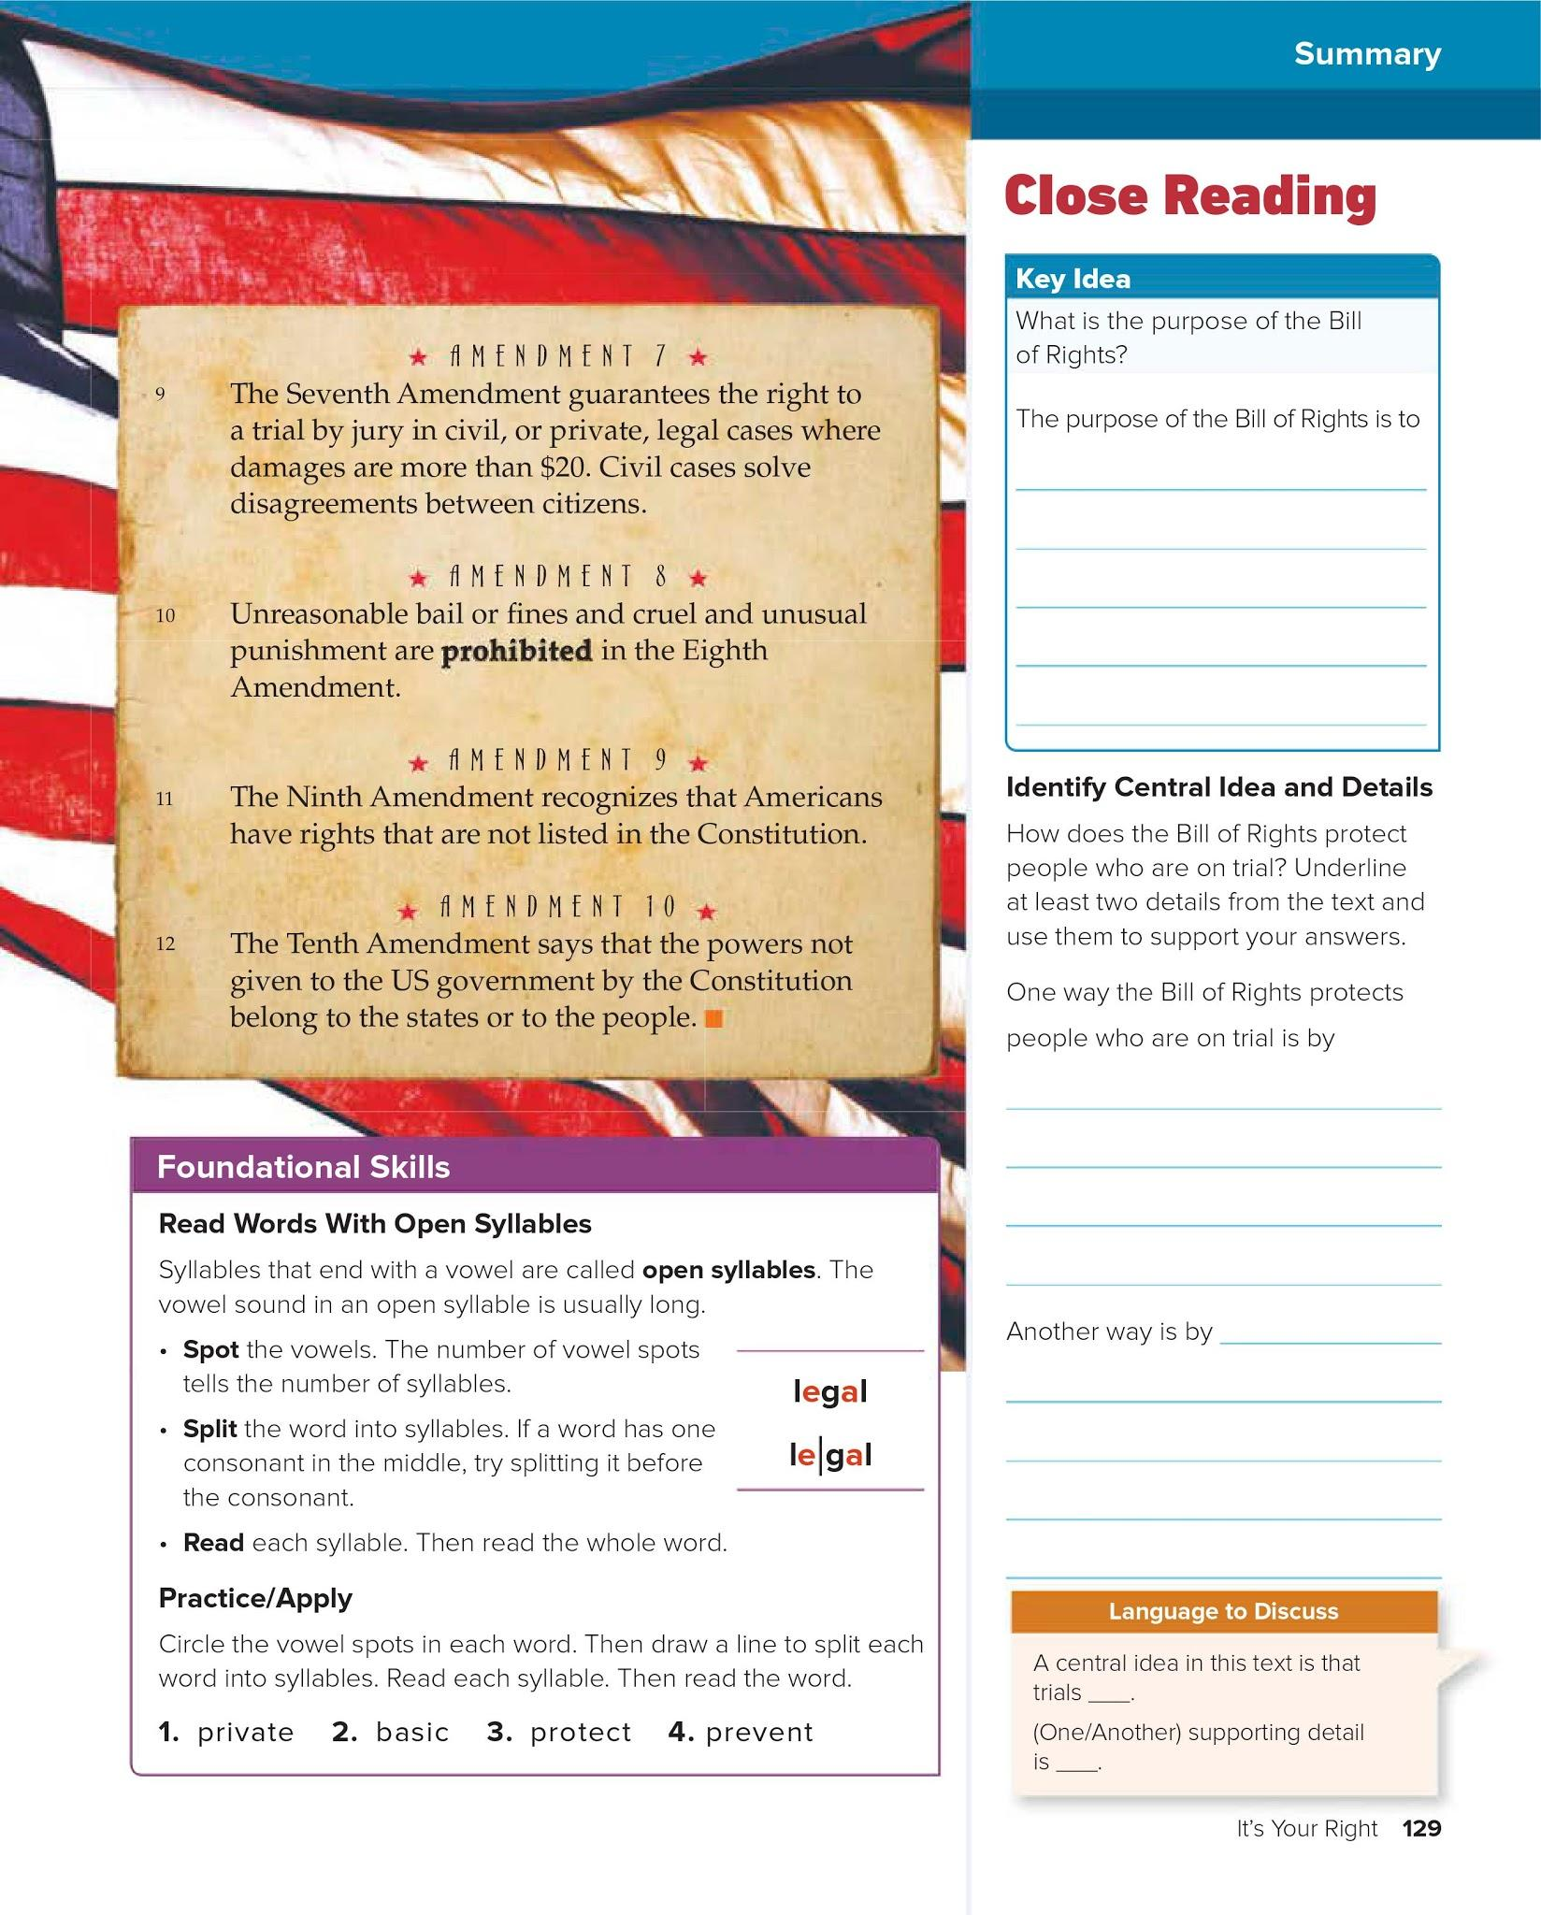
Triple click to type
Triple click to type
Triple click to type

